Slide 1
D-STAR InfoCon 2014 at Dayton Hamvention
Part 3 – Doing More With D-STAR
John Davis WB4QDX

Slide 2
What is D-RATS?
D-RATS is a free, easy to use, multi-platform data communications package that provides messaging, email, file transfer, mapping and position reporting written by Dan Smith, KK7DS
Originally developed for use with D-STAR radio
    Also used with Internet connection (no radio)
    Developing AX.25/packet interface
Download at www.d-rats.com

Slide 3
Why Use D-RATS?
D-RATS can be used for simple data communications between one or more stations
Can be used to support Emergency Communications (adopted by GA ARES as one of three data applications)
Use without radio on Internet
Allows use of tactical calls while radio transmits legal FCC callsign
Can be used for displaying positions of D-STAR GPS equipped stations

Slide 4
Who Can Use D-RATS?
Multi-platform
    Windows (2000, XP, 7)
    Mac OS
    Linux
Multiple Interfaces
    D-STAR Radio
    Internet connection
    DV Dongle
    KISS TNC

Slide 5
D-RATS Functions
Messaging – radio messages, email, Winlink 2000
Chat – quick, simple keyboard-to-keyboard, multi-user, private channels
File Transfer – unattended file sharing, upload/download from common shared site
Forms – Use predefined forms (NTS, ICS-213) or add custom forms
Mapping/Position Reporting – map download, GPS position reporting on map

Slide 6
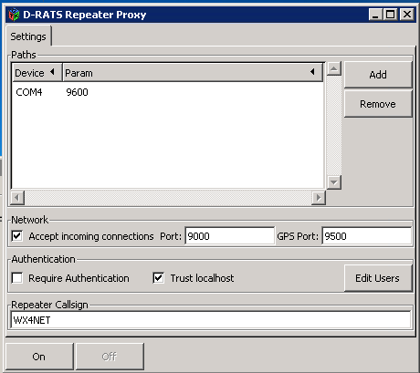
What is a Ratflector?
Bridges all connections defined (radio, Internet)
Provides path from radios to Internet for email, Winlink 2000
Allows both Internet-based and radio users to connect together
Allows bridging of multiple Ratflectors

Slide 7
Getting Started With D-RATS
Getting Started document on GwinnettARES Yahoo Group in Files section
Download and install latest version
    www.d-rats.com/download
    Current version – 0.3.3
Setup preferences
    File / Preferences (General station information)
    File / Preferences / Radio (Com ports)

Slide 8
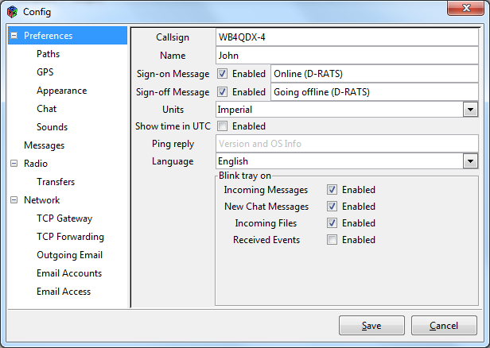
Setup – General Info
Use callsign or tactical call for EmComm

Slide 9
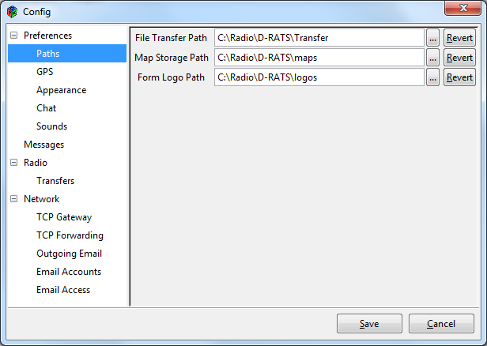
Setup -Paths

Slide 10
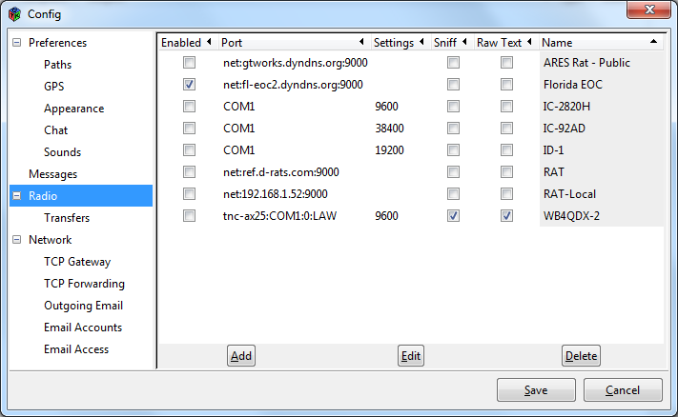
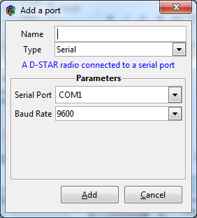
Setup - Radio
Configure radios, Ratflectors, TNCs

Slide 11
Messaging
Used to send/receive messages between stations, Internet email users
Addressable to specific station
Familiar email look and feel
Message can be email, form or memo format
Standard forms included (ICS-213, radiogram), create custom forms easily
Station to station – can use callsign or tactical call for addressing
Send and receive to Internet email addresses
Compatible with Winlink 2000 addresses
Supports attachments (small file size recommended)

Slide 12
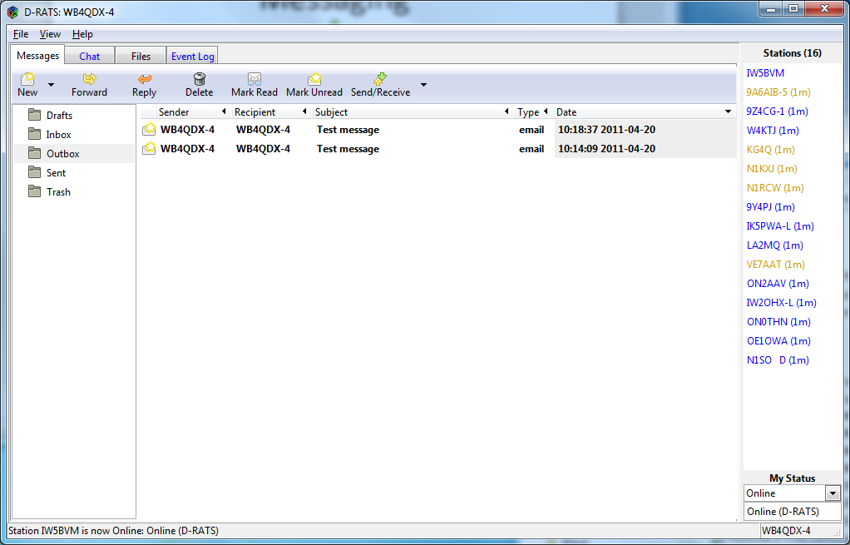
Messaging Screen

Slide 13
Chat
Chat provides broadcast messages
Can filter on strings (callsign, keywords, etc.)
Channels provide “chat rooms” off main channel
Private chat with specific stations

Slide 14
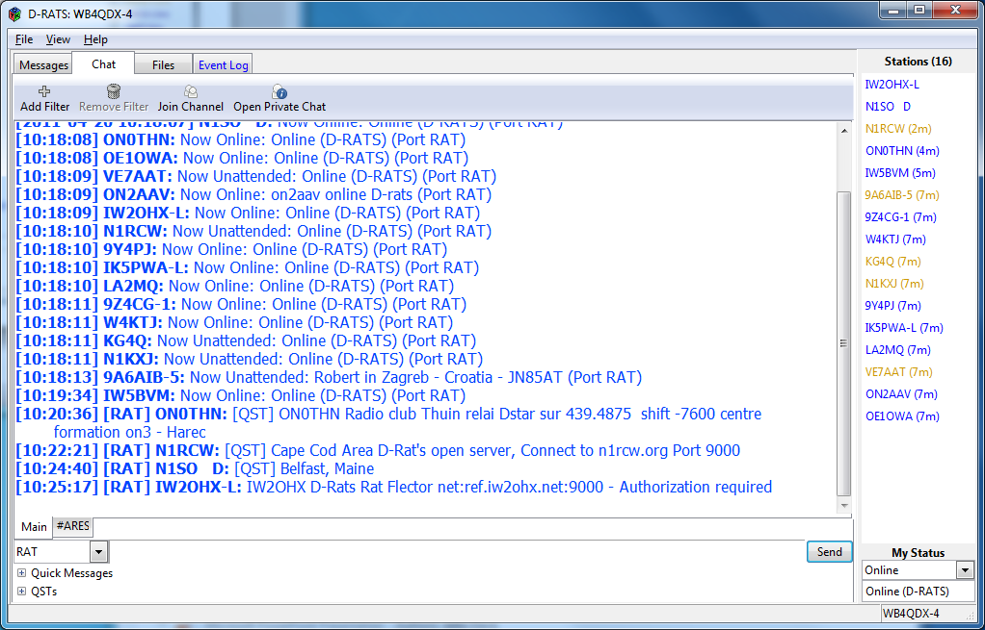
Chat Screen

Slide 15
File Transfer
Allows unattended file transfers between stations
View remote station files
File transfers use error checking
All file formats supported

Slide 16
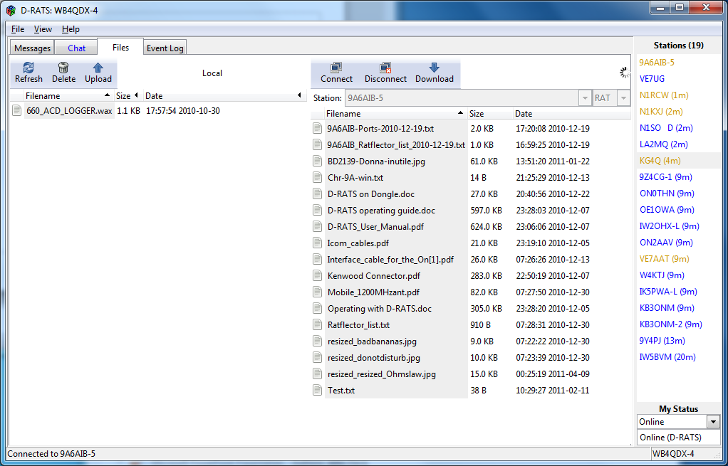
File Transfer Screen

Slide 17
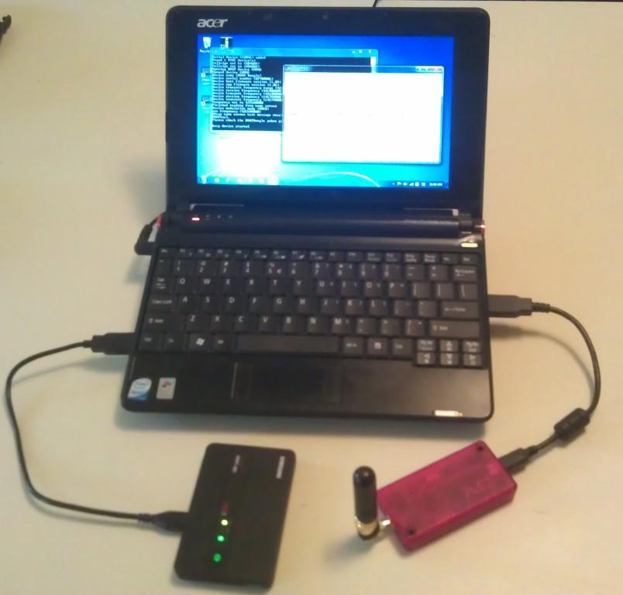
Using a DVAP
Normal connection to DVAP is a PC, Laptop or Netbook (bulky) with Internet connection

Slide 18
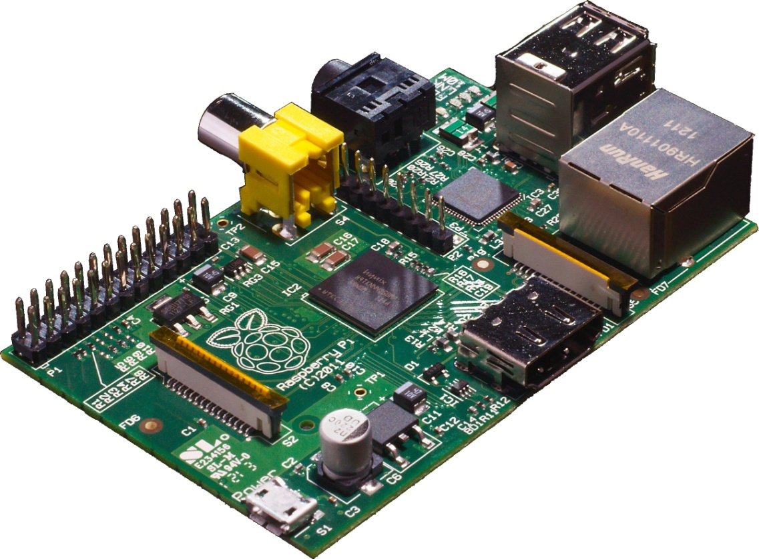
Add a Raspberry Pi?
Credit card sized Linux computer with SD Card slot, 2 USB, Ethernet and HDMI ports powered by 5VDC micro-USB adapter

Slide 19
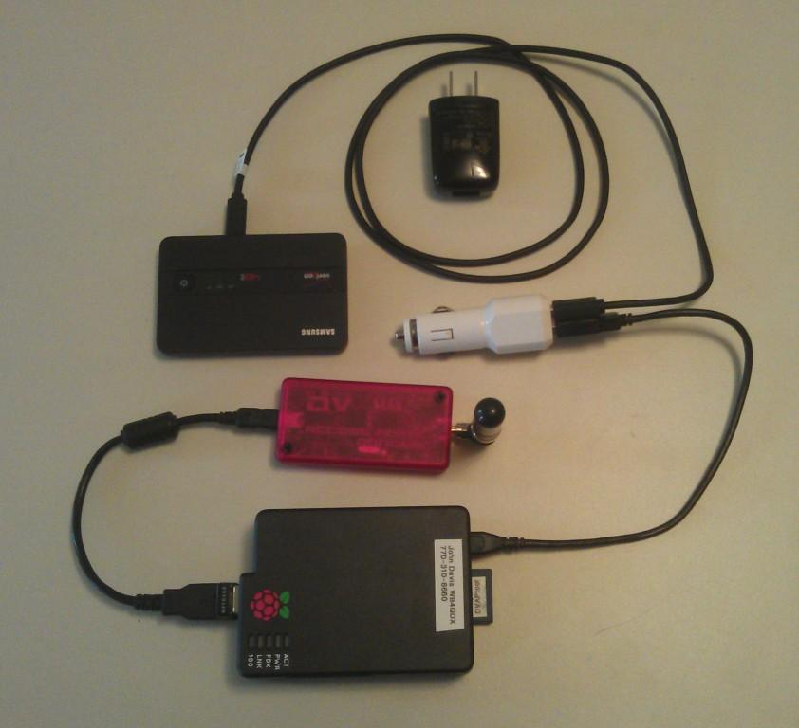
DVAP / Pi Configuration
DVAP connects to Pi through USB
Wi-Fi adapter on 2nd USB (external Internet source required)
SD card with OS and DVAP software
Micro USB power to AC or DC source

Slide 20
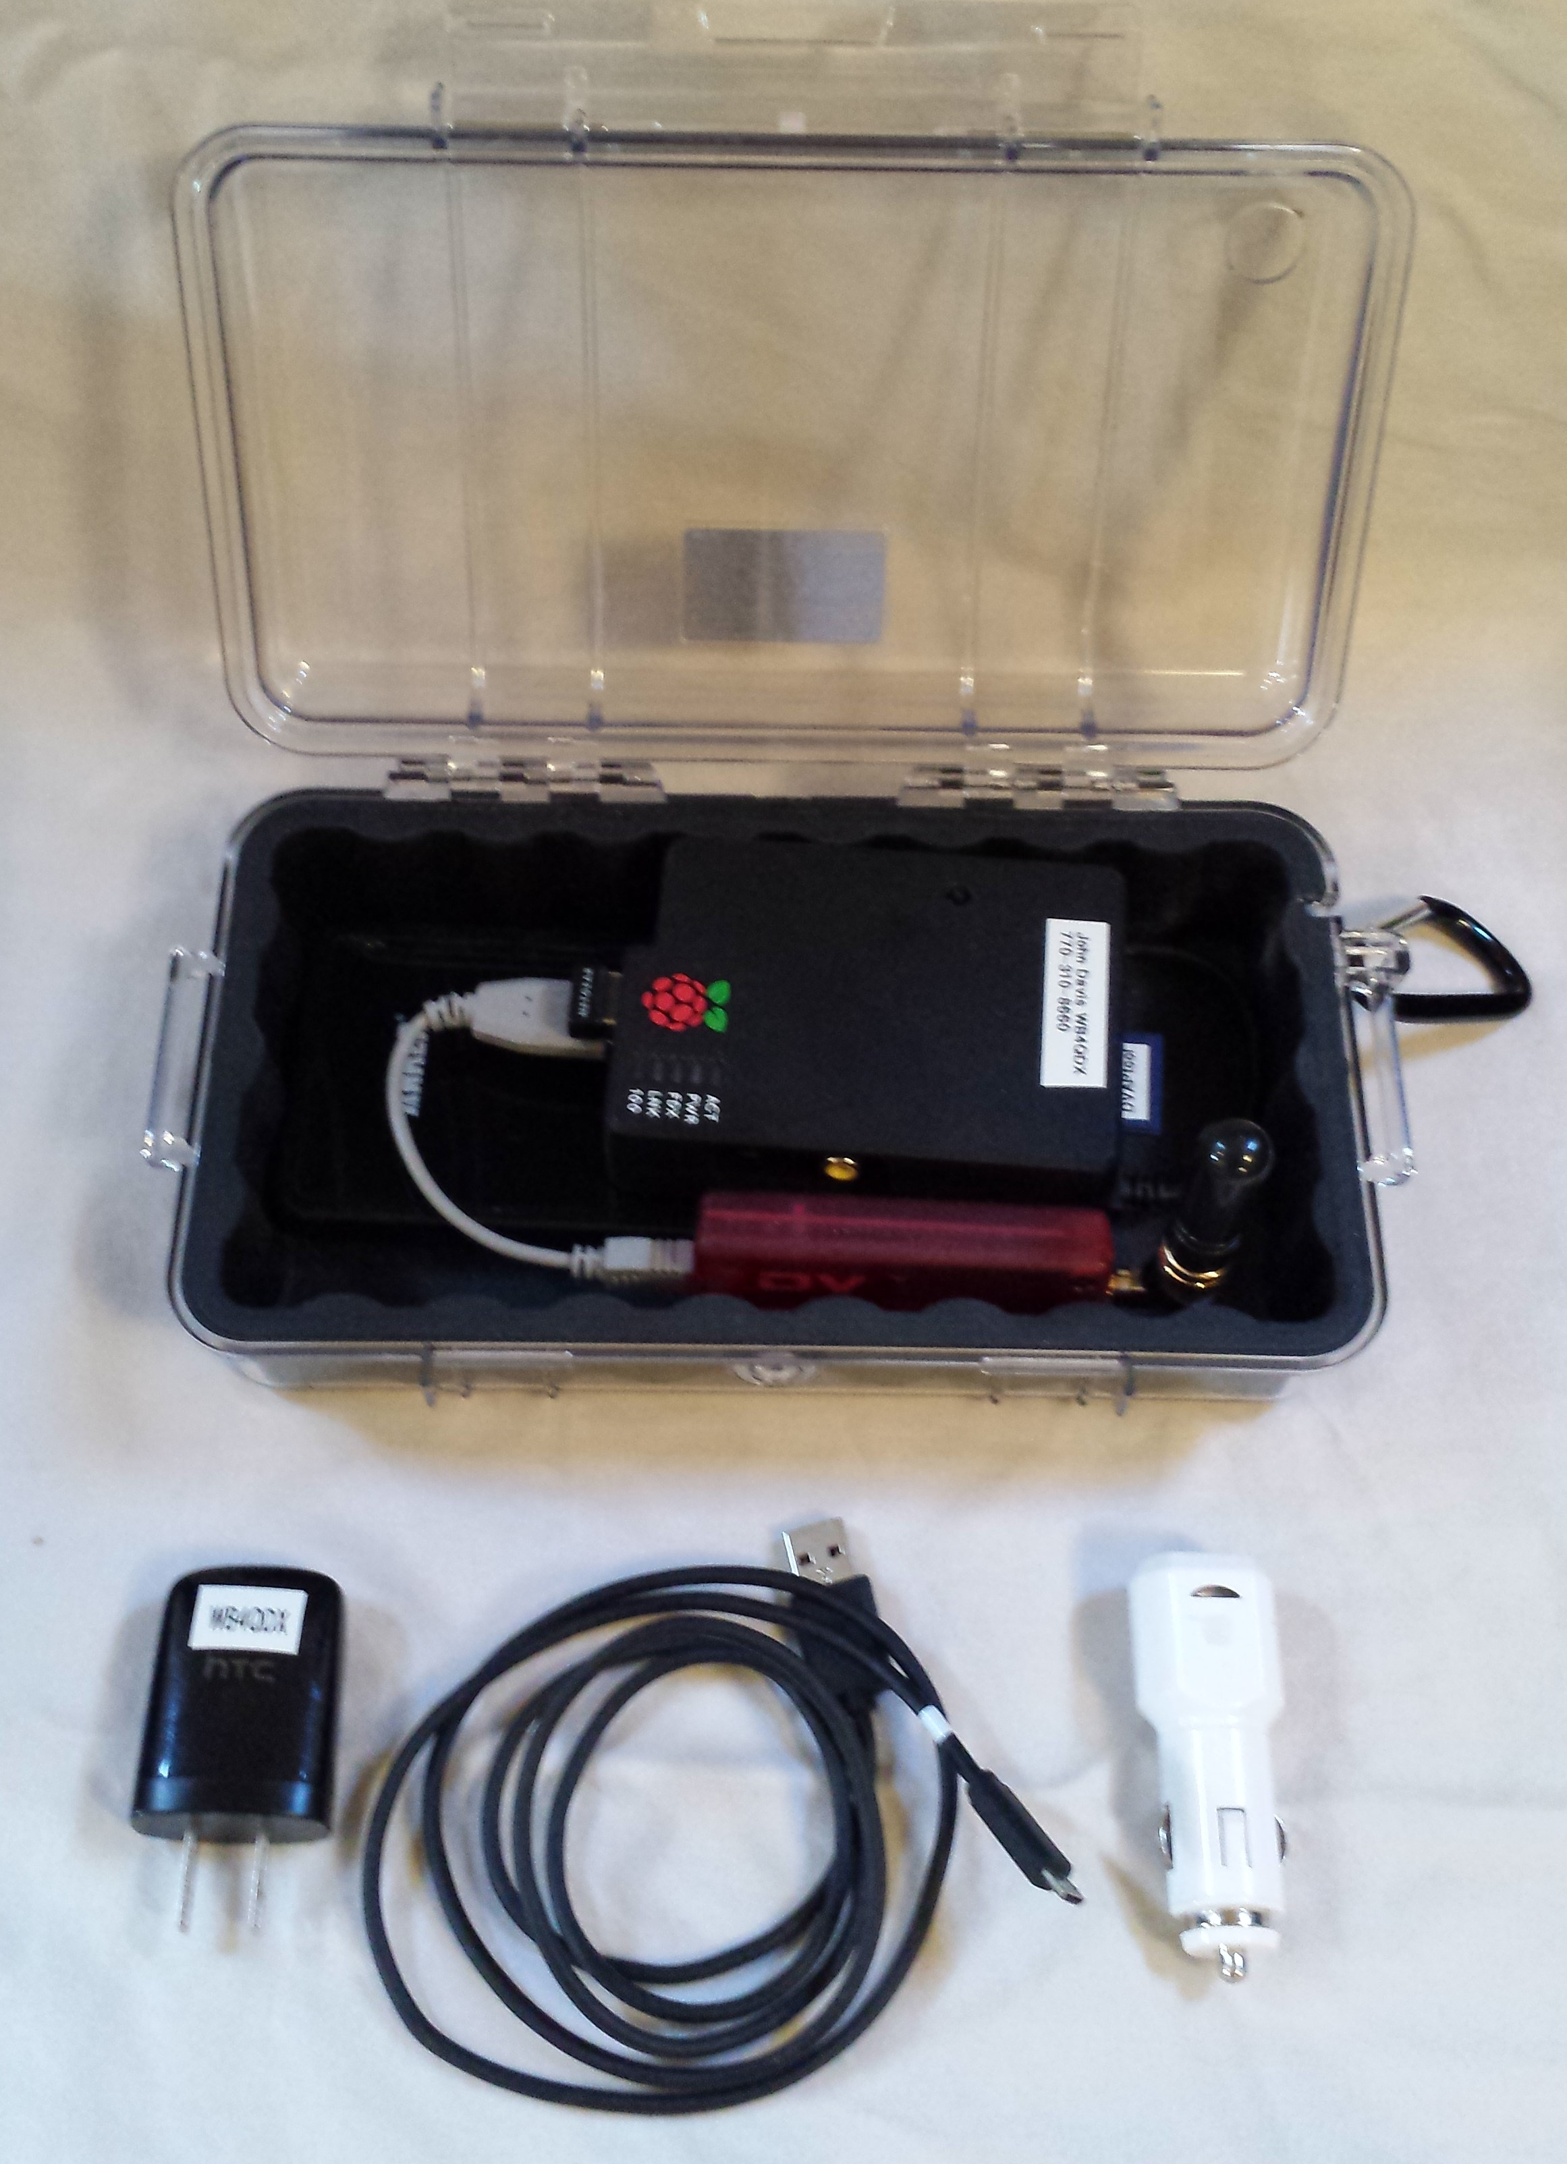
Homebrew DVAP Package
Pelican 1050 or 1060 Case
Raspberry Pi Model B
USB Charger/5VDC Supply
Anker 10,000 mAH or
equivalent
DV Access Point
USB Adapter
(120VAC to 5V USB)
USB CLA (12V to 5V USB)
Micro-USB Cable

Slide 21
Making It Work
Download image file and instructions
  DVAPtool version:
  https://www.dropbox.com/sh/mfyw3j6dwkpmriz/V56pE5JqTL
  ircDDB version:
  http://www.westerndstar.co.uk/Downloads/DVAP+ircDDB+VNC.rar
Install OS image to SD card using Win32DiskImager
Power up Pi with SD card installed, HDMI monitor, keyboard, mouse and Internet connection (Ethernet or Wi-Fi)
Configure DVAPtool or DVAPnode and ircDDB per instructions
Configure WiFi sources (Mobile Hotspots, home WiFi, etc)
Can run “headless” after that…just power up, finds defined WiFi sources

Slide 22
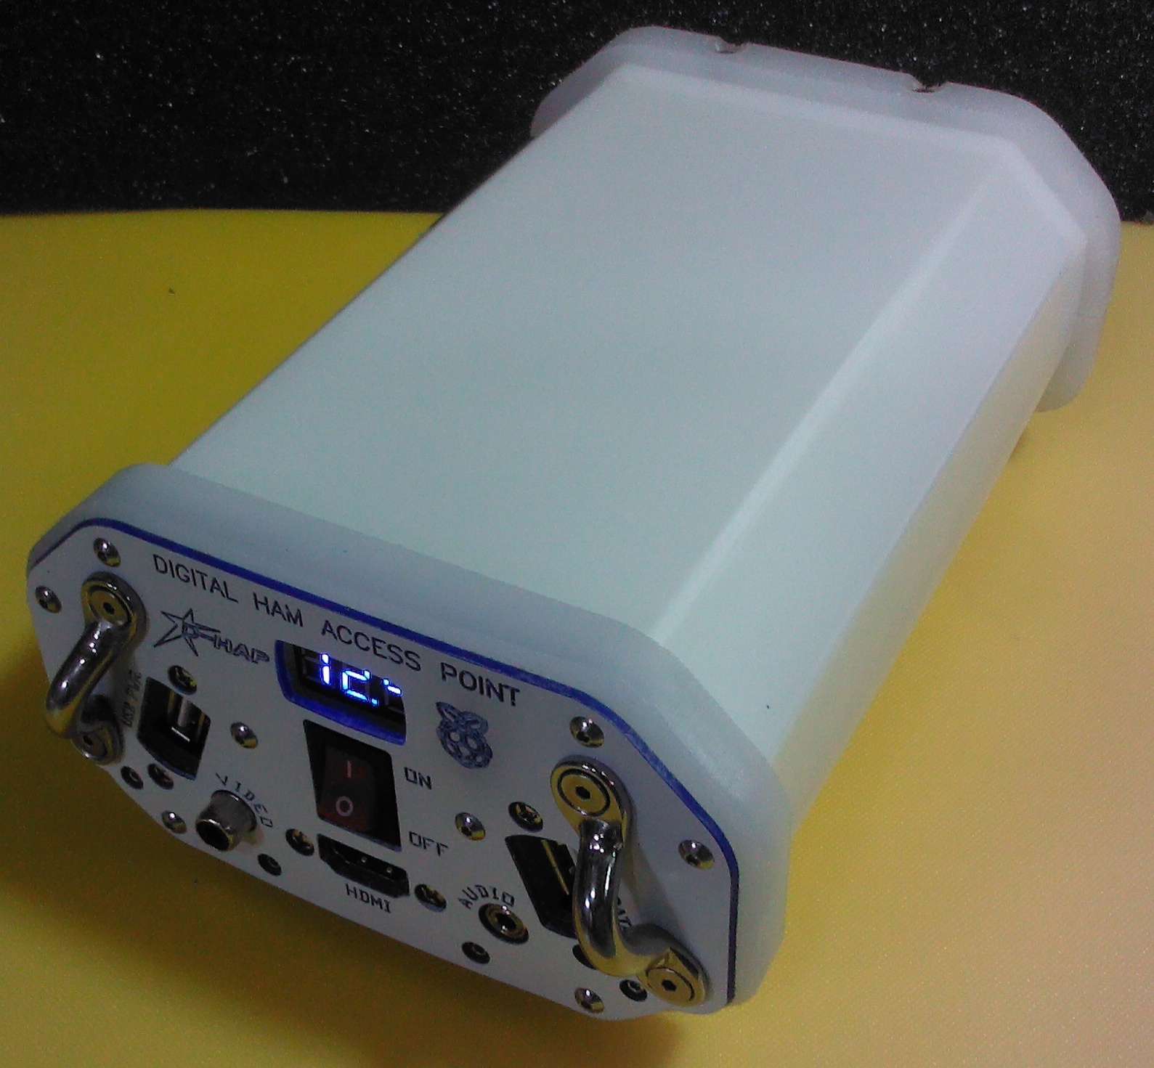
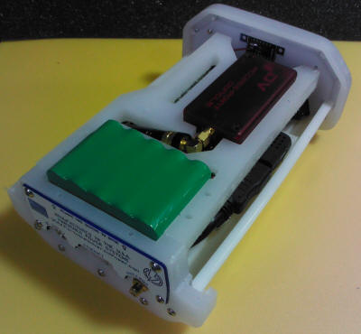
DHAP
Commercially available from Hardened Power Systems
http://www.portableuniversalpower.com/DHAP.htm
User supplies DVAP (2m or 70cm)

Slide 23
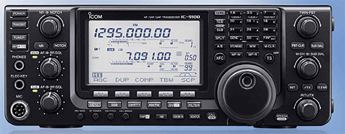

D-STAR on HF
Icom IC-7100 and IC-9100 are both DV capable on HF
Operates at similar bandwidth to AM
D-STAR HF nets now operating several nights a week
Net info at
http://www.dstarinfo.com/DSTARHFNet.aspx

Slide 24
ID-5100 Demo

