Slide 1
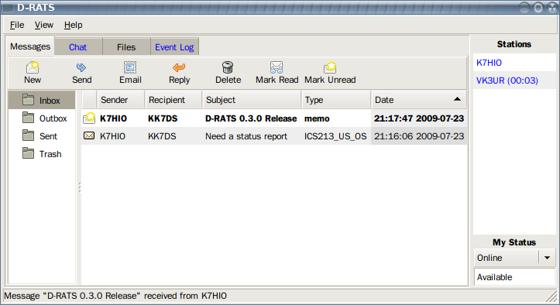

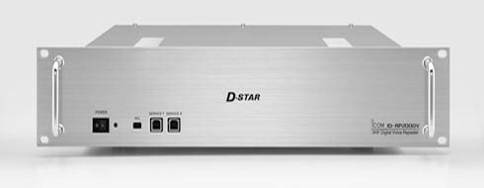
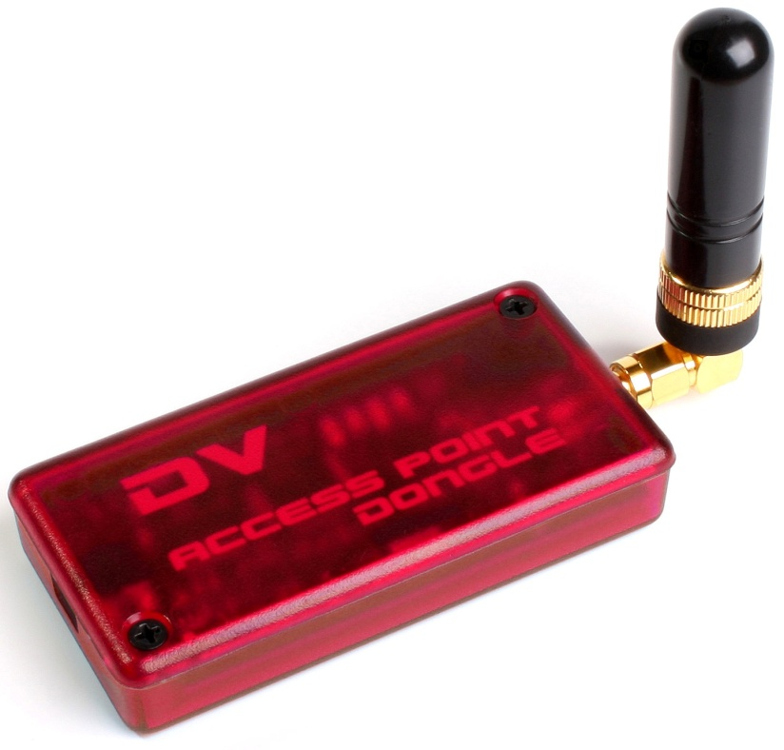

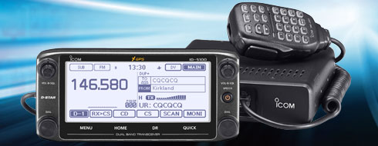
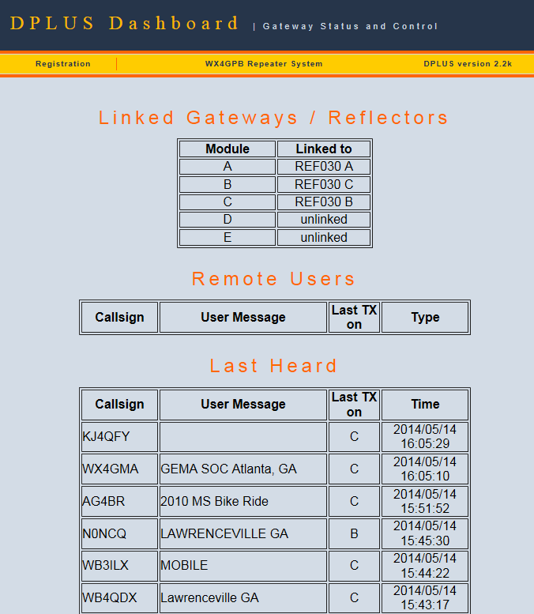
D-STAR Update
John Davis WB4QDX

Slide 2
D-STAR Continues to Grow
As of May 14,2014
  Over 32,000 registered users worldwide
  Over 1,760 registered gateways (G2 and ircDDB)
  56 Active DPLUS reflectors
  31 DCS reflectors
  46 XREF reflectors
  Over 3,000 D-STAR Repeaters
  Over 72 D-STAR nets
  D-STAR remains the most active digital mode in Amateur Radio with the largest number of users
2

Slide 3
National Hurricane Net
D-STAR invited to participate in hurricane and tropical storm weather reporting with National Hurricane Center and WX4NHC
    Voice reports through SE D-STAR Weather Net on linked repeaters to REF002A
    D-RATS reports on drat.seweather.net
Net will be activated during any weather system approaching US landfall
WX4NHC/Hurricane Net first test on Saturday, May 31 from 10a-12n EDT for D-STAR
Southeast D-STAR Weather Net operates weekly on Sunday evenings 9:00pm ET on REF002A

Slide 4
D-STAR HF Operation
DV mode operates on HF frequencies with IC-7100, ID-9100 and HF rigs with data port and GMSK modem board
DV mode is roughly AM bandwidth
D-STAR HF Net operates on 80m-6m bands
Coordinates band changes on REF030C
Net operates on Tuesday, Thursday, Saturday, Sunday skeds
Complete net info at hf.dstar-relay.net

Slide 5
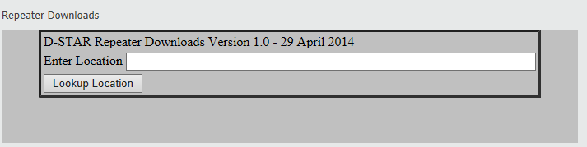
New Download Capabilities
Available at www.DSTARinfo.com
New download features added for standard memories and repeater lists (DR)
Geocoded FM repeaters available for new ID-5100
Choose mix of FM and DV repeaters based on a specified location

Slide 6
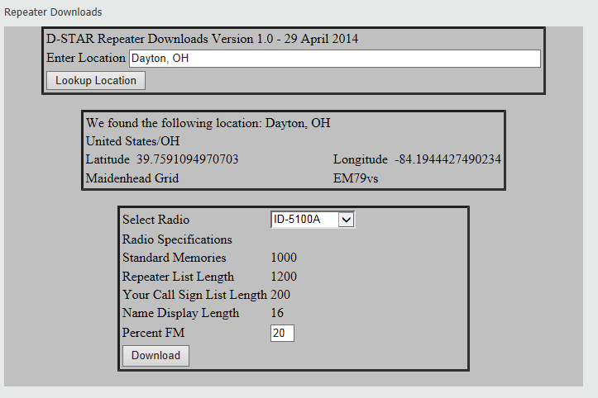
Repeater Downloads (Beta)

Slide 7
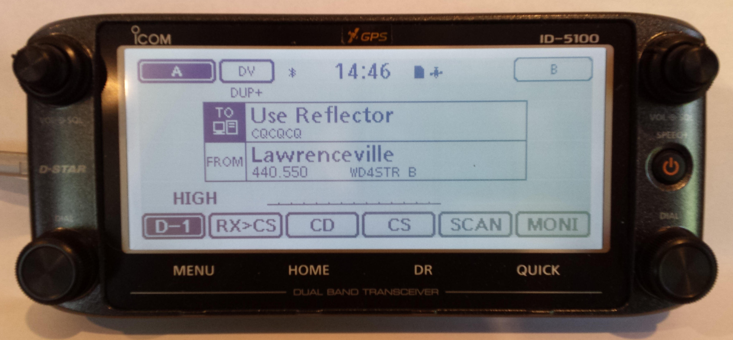
Are you using DR Mode?
DR Mode available on ID-31, ID-51, ID-5100, IC-7100
Simplifies D-STAR programming
Includes geocoded Repeater List for Nearest Repeater selection
FROM selects desired repeater
TO selects CQCQCQ for talk and linking to repeaters and reflectors

Slide 8
Expand Your D-STAR Repeater
DSTARinfo.com is giving away a free Icom RF Module or 50% off Icom controller and RF Module
Open to US clubs
Register at D-STAR Booth (HA0010) or Friday Night D-STAR at Drury Inn (6:30-8:30pm)
Winner will be drawn at the D-STAR booth in the main arena on Sunday morning at 10am
One entry per person

