Slide 1
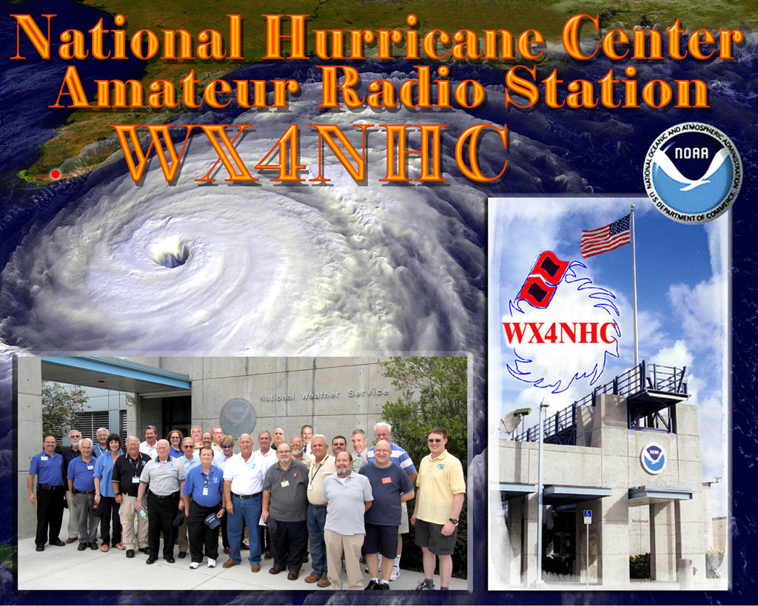
National Hurricane Net
John Davis WB4QDX

Slide 2
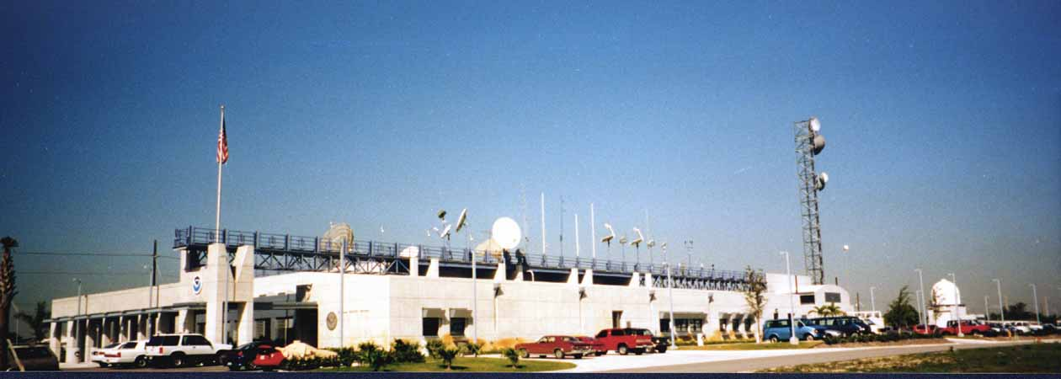
Amateur Radio at NHC
National Hurricane Center is located on campus of Florida International University in Miami, FL
Hurricane hardened facility
WX4NHC is Amateur Radio Station onsite

Slide 3
WX4NHC Purpose and Goals
Collect weather data “Surface Reports” from the Hurricane affected areas in real time for use by the Hurricane Forecasters
Provide back-up emergency communications to and from the Hurricane Center during and after a direct hit on Miami
Provide Hurricane Advisories over Ham Radio, when other sources are not available to the affected area
Enhance and promote the accuracy and availability of weather data surface reports

Slide 4
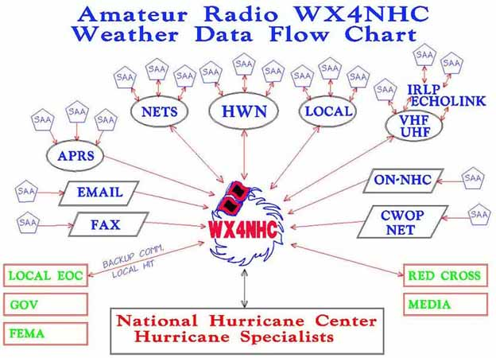
WX4NHC Info Flow

Slide 5
Adding D-STAR Reporting
D-STAR

Slide 6
D-STAR Reporting to WX4NHC
Adding D-STAR increases number of reporting stations
Southeast D-STAR Weather Net will expand to operational mode during hurricane activation
Repeaters will link to REF002A for voice
Net Control Station will collect voice reports
D-RATS can be used for reports and submitting forms (drat.seweather.net)
Local observed weather conditions reportable to NCS
NCS will relay info to WX4NHC

Slide 7
How to Report
Weather station info is most accurate source
Report temperature, wind speed, direction, rainfall rate, barometric pressure and time of report
Use info format from form available at www.dstarinfo.com/hurricane
D-RATS form template to be available for import
Be complete, be accurate

Slide 8
WX4NHC Net Test
WX4NHC will conduct a net test from 9a-6p ET on Saturday, May 31
D-STAR net will be active on REF002A from 10a-12n for reporting
D-RATS will be active on hurricane.gaares.org
All station should report current local conditions for test

