Slide 1
D-STAR Dayton 2014

Slide 2
Schedule
Introductions
A Brief History of D-STAR
Growth of D-STAR
D-STAR versus ……
Trust Server Team Update
A local net becomes the National Hurricane Net
Self-contained Hot-Spot - DHAP
D-STAR compatible Homebrew
Corner Discussions

Slide 3
History of D-STAR –Labor Pains
Event | Date
Corporate HQ Introduction | 2001
JARL published protocol | 2001
Tokyo HamFair | 2002
Dayton | 2002
TAPR DCC | 6/2002
D- STAR Introduced in Dayton | 5/2003
ID- RP1D/VS – 1.2GHz Repeater (K5TIT) | 2003
D-STAR Concept Article in QEX | 2003
ID-1 | 8/2003
IC2200H | 3/2004
ID-800H | 3/2005

Slide 4
D-Star Repeaters 2005

Slide 5
History of D-STAR – Infancy
Event | Date
Gateway V1 Released | 2005
D-STAR 101 Class | 8/2005
48 Users | 2006
DSTAR Monitor | 2006
DSTARUsers.org | 2006
DPRS | 2006
RP2000, RP4000 | 5/2006
IC-91AD | 5/2006
RP2C, RP2D, RP2V – Upgraded Repeater | 7/2006
ID-2820 | 3/2007
Dayton Buy 10 ID-1 Get a RP2 Free | 5/2007
534 Users / 36 Repeaters | 5/2007
Huntsville Gateway Class | 8/2007
DVDongle | 12/2007
ID-92 | 2/2008

Slide 6
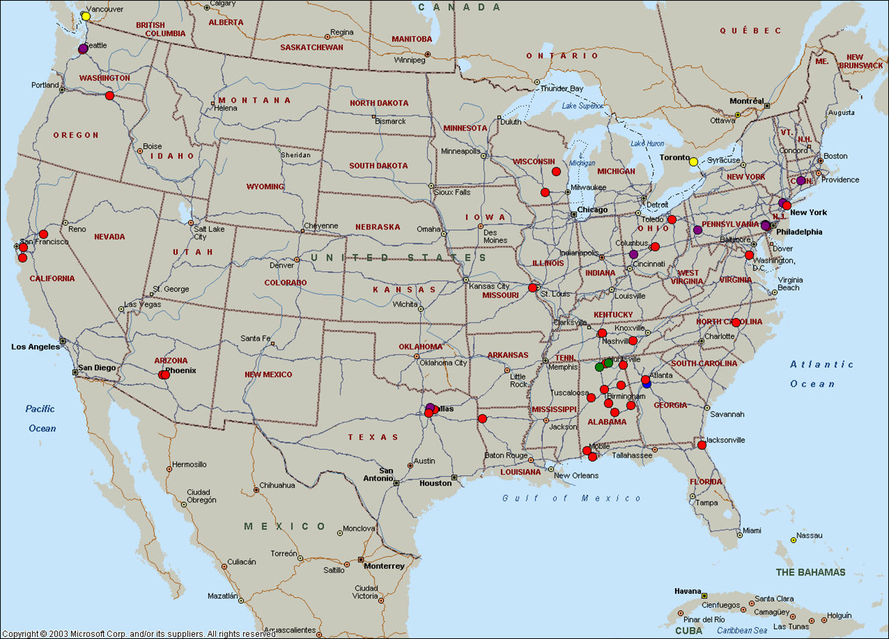
D-STAR Repeaters 2006

Slide 7
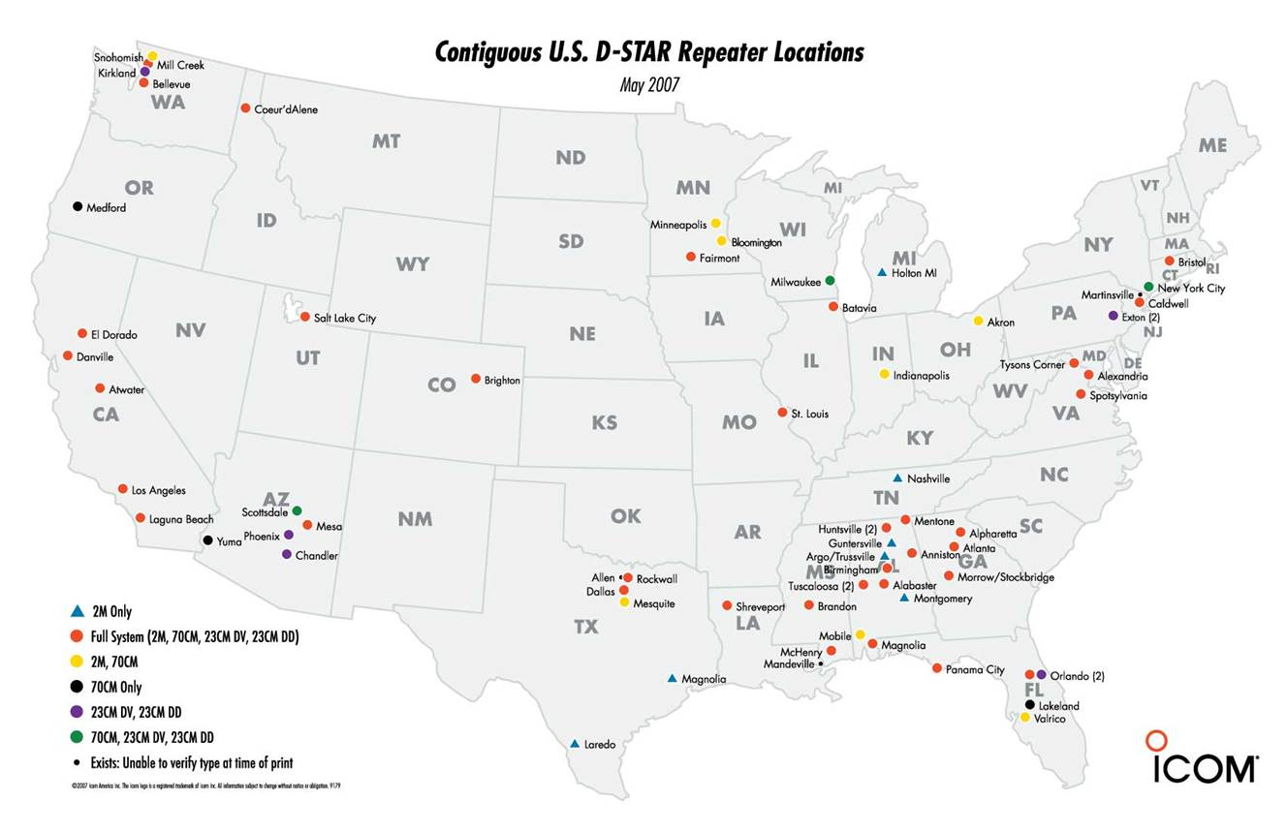
D-STAR Repeaters 2007

Slide 8
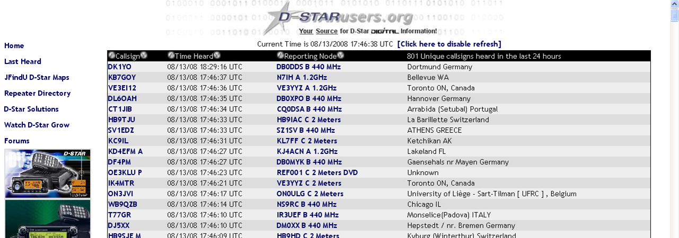
DSTARUsers.Org Last Heard List

Slide 9
History of D-STAR - Adolescence
Event | Date
Icom releases “G2” software All users had to re-register Multi- cast support | 3/2008
DPlus 2.0 released | 3/2008
Chirp D-RATS DCHAT | 2008
DSTARInfo | 4/2008
First contact to Japan from Dayton | 5/2008
201 Repeaters | 8/2008
DVAP | 2/2010
ID-80/ID-880H | 4/2010
ID-9100 | 3/2011

Slide 10
History of D-STAR - Puberty
Event | Date
ID-31 | 4/2012
ID-51 | 4/2013
ID-7100 | 7/2013
ID-5100 | 4/2014
RS-MS1A Android App | 3/2014

Slide 11
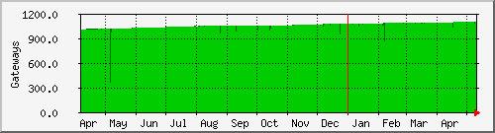
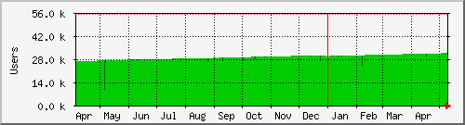
Growth of D-STAR
Gateways
User Registrations
1,101 Gateways on US Trust Server
Increase ~100
31,500 User Registrations
Increase ~3,000

Slide 12
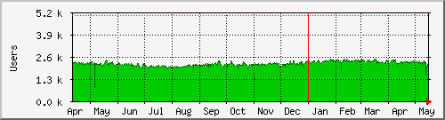
Daily D-STAR Usage
~2,200 Users / Day

Slide 13
D-STAR Strength
Total D-STAR Systems
Penetration
1510 D-STAR Systems
(includes IRCddb and non-Internet connected)
2786 D-STAR Repeaters (Including DD)
48 States plus DC
48 Countries

Slide 14
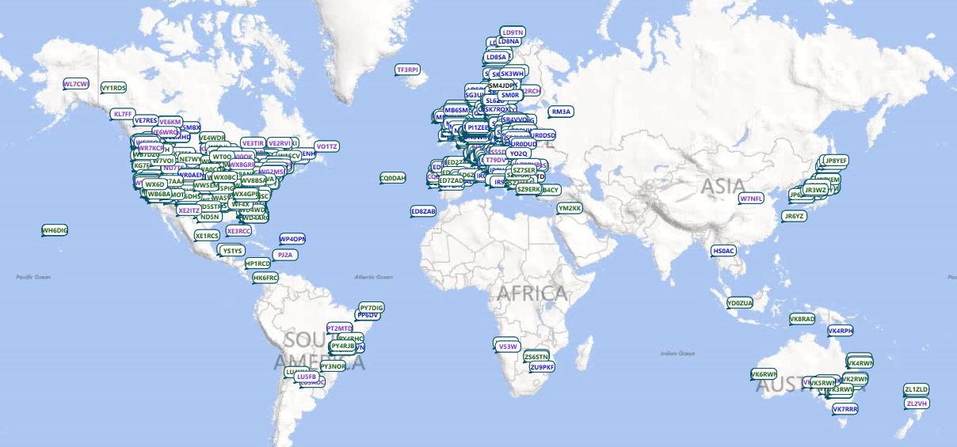

Slide 15
D-STAR Strength
Worldwide Leaders
US Leaders
Country | Total | Voice | Data
United States | 1109 | 979 | 130
Germany | 220 | 214 | 6
Canada | 190 | 169 | 21
United Kingdom | 176 | 176
Italy | 172 | 156 | 16
Sweden | 148 | 148
Japan | 117 | 92 | 25
Poland | 98 | 98
Australia | 56 | 49 | 7
Denmark | 55 | 55
State | Total | Voice | Data
Texas | 89 | 70 | 19
Florida | 86 | 80 | 6
California | 78 | 67 | 11
Georgia | 75 | 57 | 18
Alabama | 65 | 55 | 10
Ohio | 54 | 50 | 4
Washington | 48 | 44 | 4
Connecticut | 38 | 37 | 1
New Hampshire | 33 | 32 | 1
Illinois | 31 | 30 | 1

Slide 16




D-STAR vs……
Function | D-STAR | System Fusion | DMR
Call Signs in Data Stream
Position Reporting
Front Panel Programmable
Ease of Programming | Out of Box | Same as FM | Very Different
Voice Quality | Good | Better, Bestest | Better
Repeater Linking | User Controlled | User Controlled ??? | Pre-defined Channel Selection
Interconnection Method | Native | WIRES-X ??? | C-Bridge
Repeaters Dual-Mode
Internet Accessible
Home-Grown Repeaters
Modulation | GMSK 6.25 kHz | 4FSK 12.5 kHz | 4FSK TDMA 2 Ch / 12.5 kHz

Slide 17
Repeater Linking
D-STAR provides complete end-user control of repeater linking
D-STAR provides reflectors
Automated Linking functions
Link commands may be stored in memory

Slide 18
Schedule
Introductions
A Brief History of D-STAR
Growth of D-STAR
D-STAR versus ……
Trust Server Team Update
A local net becomes the National Hurricane Net
Self-contained Hot-Spot - DHAP
D-STAR compatible Homebrew
Corner Discussions

