Slide 1
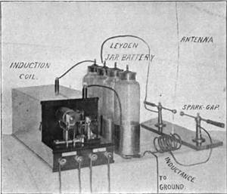
D-STAR Home Brew
D-STAR at the Drury
Ed Woodrick WA4YIH
Dayton 2015

Slide 2

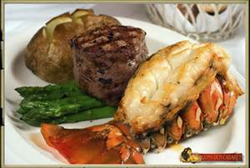
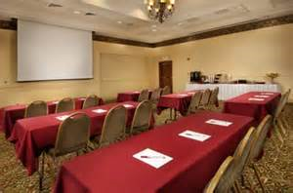

Our Sponsors

Slide 3
Evening Schedule
D-STAR Statistics
P-25 from Icom
DR Mode
DV Pro
D-STAR Homebrew Overview
  Promoting D-STAR
  DPlus, DVDongle, DVAP, ….
  DV Mega
  Dutch*Star
  Show and Tell

Slide 4
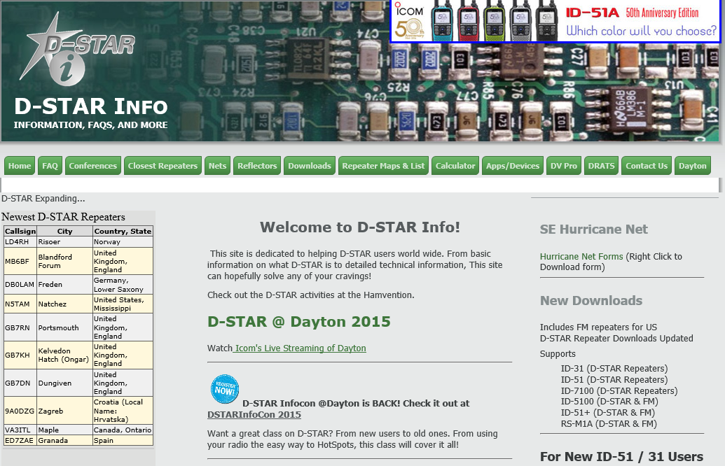

Slide 5
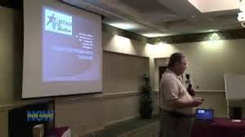
D-STAR InfoCon
Fourth Year
Three Hour Class on
Friday Morning
~40 attendees
Icom 51A Anniversary Edition
was given away

Slide 6
D-STAR Strength
WW Leaders (3191 Total)
US Leaders (1121 Total)
Country | Total | Voice | Data
United States | 1121 | 991 | 130
Germany | 258 | 252 | 6
Canada | 240 | 217 | 23
Sweden | 205 | 205
Italy | 197 | 185 | 12
United Kingdom | 192 | 191 | 1
Japan | 135 | 105 | 30
Poland | 128 | 128
Denmark | 89 | 89
Australia | 57 | 51 | 6
State | Total | Voice | Data
Texas | 93 | 77 | 16
Florida | 77 | 72 | 5
Georgia | 75 | 57 | 18
California | 64 | 55 | 9
Alabama | 58 | 49 | 9
Ohio | 55 | 51 | 4
Washington | 47 | 42 | 5
Illinois | 38 | 37 | 1
Pennsylvania | 32 | 27 | 5
Louisiana | 31 | 27 | 4

Slide 7
US Trust Server Team
Jim McClellan - N5MIJ
Bill Moore – N5ZPR
Brian Roode – NJ6N
Darren Storer – G7LWT
Fran Miele – W1FJM
Fred Varian - WD5ERD
Gerry Dalton – W5MAY
Pete Loveall – AE5PL

Slide 8
DR Mode
The easiest way to use your radio

Slide 9
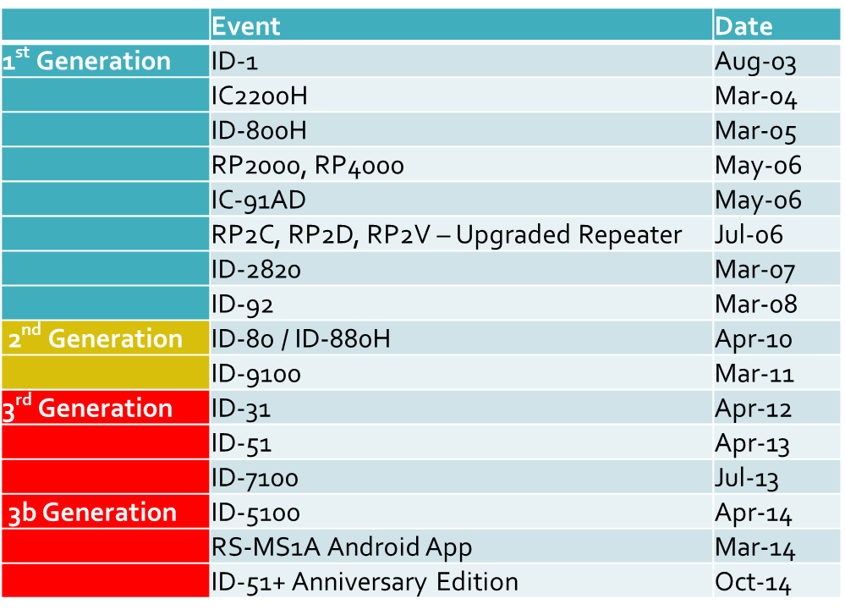
Radios Supporting DR Mode

Slide 10
DR Mode – USE IT!!!!
Digital Repeater Mode
Radios have a database of Repeaters and Destinations
Easy to Use
  Pick Source Repeater
    Updateable List
    Nearest Repeater
  Pick Destination / Function
Automatic Programming of Radio

Slide 11
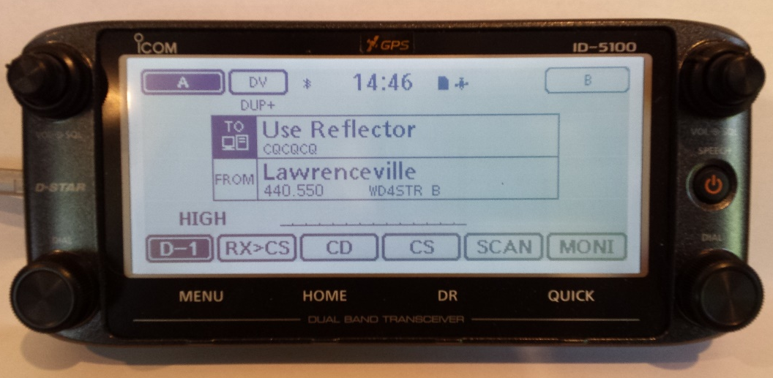
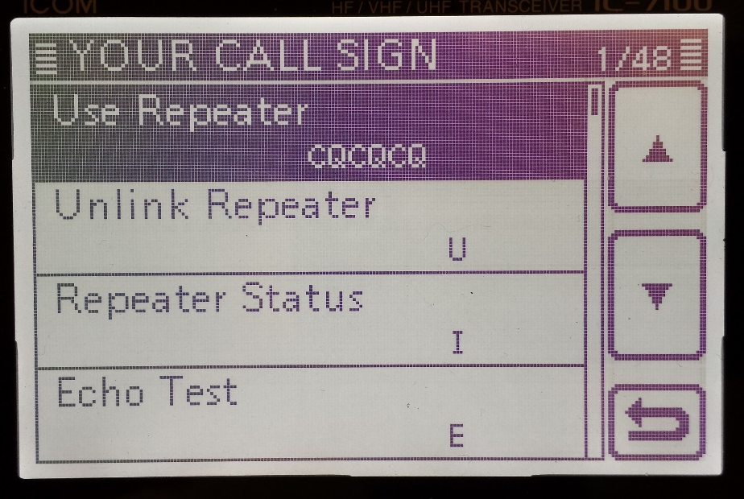
Using DR Mode
Select TO on screen
Select “Your Call Sign”
(“Reflector” on ID-5100 / ID-51+)
Select “Use Repeater”
“Link to Reflector” on ID-5100 / ID-51+)
Not CQCQCQ !

Slide 12

Updating Your Radio
Updated using Icom Software
Updated information from www.DSTARInfo.com
  Can import into Icom software and program radio
  Can write to SD card and import into radio
  New Your Call and Repeater List Downloads Soon
Updated using RT Systems software
www.rtsystemsinc.com

Slide 13
Icom’s P-25 Update
Paul Wardner

Slide 14
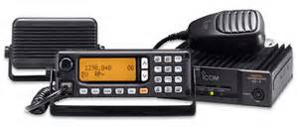
D-STAR Homebrew
The beginnings….

Slide 15
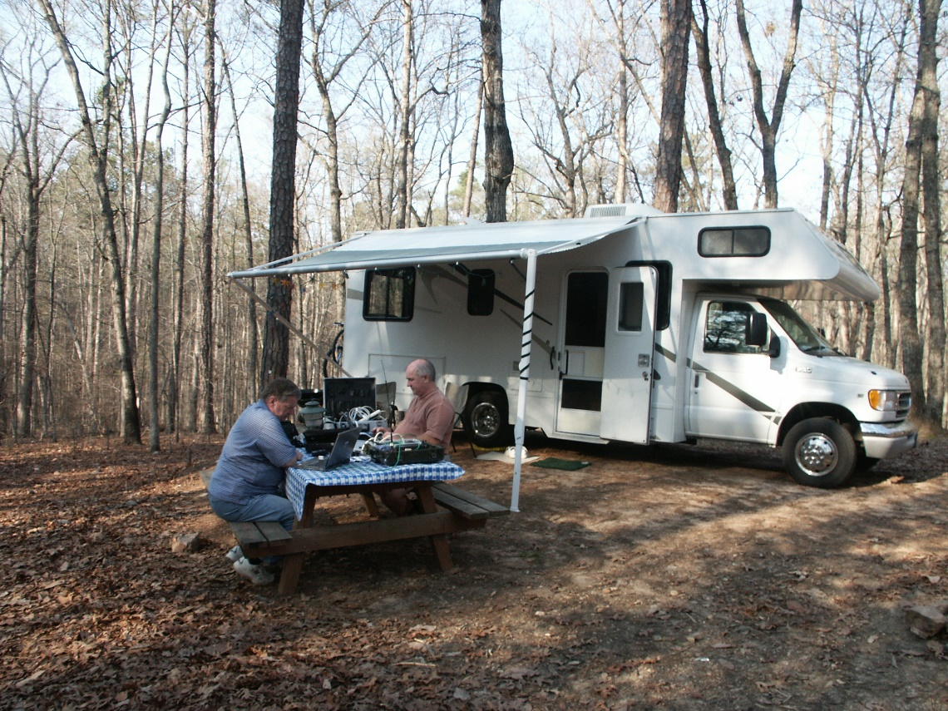
John Davis – WB4QDX
Promoting D-STAR
March 2008

Slide 16
D-STAR
If I build it will they come?
John Davis, WB4QDX
wb4qdx@arrl.net

Slide 17
Getting it started
Any new technology requires care and feeding to grow
Many are reluctant to change
There is a cost to participate
Getting a system on the air is only the first step

Slide 18
Doing the Ground Work
What do I want to accomplish?
How active is VHF and UHF activity in my area?
Is there an active EmComm group locally?
Do I have a repeater site?
Is there Internet connectivity available at the site?
Is there an unused repeater in the area?
Are there available repeater pairs that will coordinate?

Slide 19
Building the Foundation
Build a core interest group
Decide on repeater equipment
    Commercially available D-STAR repeater
    Build a repeater using components and FM radios (PC, GMSK modem, quality radios, software)
    Consider speed of construction and complexity
Get involvement from the start and talk it up

Slide 20
Once on the air……
Talk, talk, talk and demonstrate to others
    Principle of Advertising – it takes three impressions to hear the message
Give demos at clubs, EmComm groups
Have periodic local gatherings to share ideas, experiences and generate more interest
Educate – hold training events and demos
Provide resources to existing and potential users
    Online videos
    Websites
    Yahoo groups
    Build local radio memory files to assist new users
Enlist the help of experts
    Conference calls
    Webinars
    Virtual training

Slide 21
How do I learn about D-STAR?
Nifty E-Z Guide to D-STAR Operation
www.DSTARinfo.com
    Memory downloads
    Instructional videos
Yahoo groups
YouTube videos
    Specific radio operation
    Speakers at events
    How-to videos

Slide 22
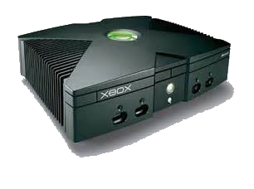
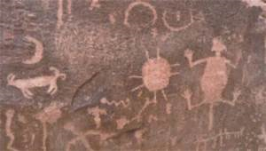
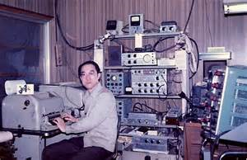
Early Software
Original Last Heard List
First DSTARInfo.com Website
Dan KK7DS working on first D-RATS

Slide 23
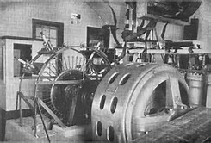
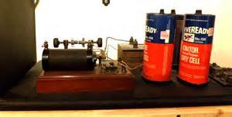
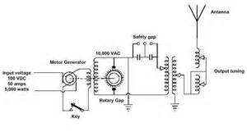
Early Hardware Prototypes
Early DV Dongle
DV Mega Dual-band Transceiver
Star Board GMSK Adapter

Slide 24
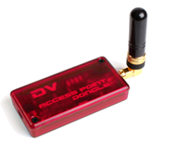





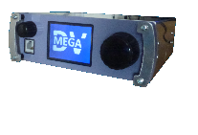



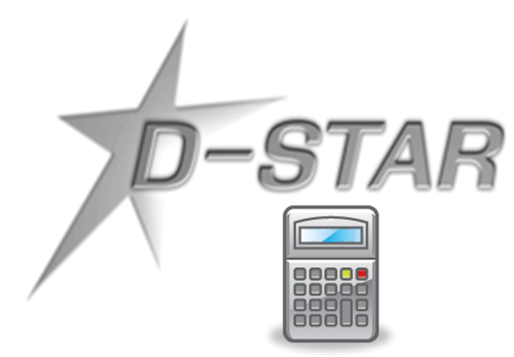
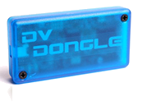

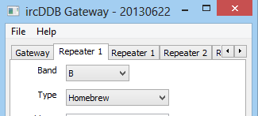

D-STAR Grows From the Field
Notes:
D-PRS Pete Loveall AE5PL
D-Star Chat Brian Roode NJ6N
DPLUS Robin Cutshaw AA4RC
DVDongle Robin Cutshaw AA4RC
D-RATS Dan Smith KK7DS
ircddbgateway Jonathan Naylor G4KLX
USTrust compatible David Lake G4ULF
Moencomm Jim Moen
NW Digital John Hays K7VE, Bryan Hoyer K7UDR
DV Mega Guus van Dooren PE1PLM
Dutch*Star Fred van Kempen PA4YBR

Slide 25
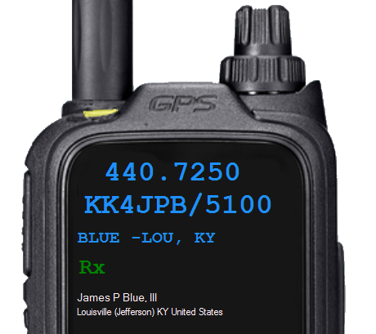
DV Pro
Persistent Display of Last Station Heard
Local Last Heard List
Distance and Direction to Station
QRZ Lookups
D-STAR Net Control
Currently Supports
  ID-5100
  ID-51+
  ID-7100
More to Come!
www.DSTARInfo.com
DVPro

Slide 26
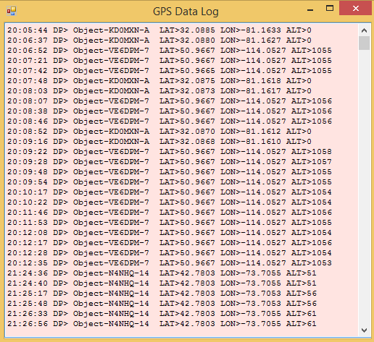
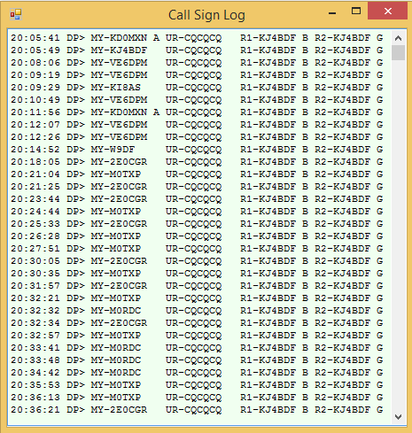
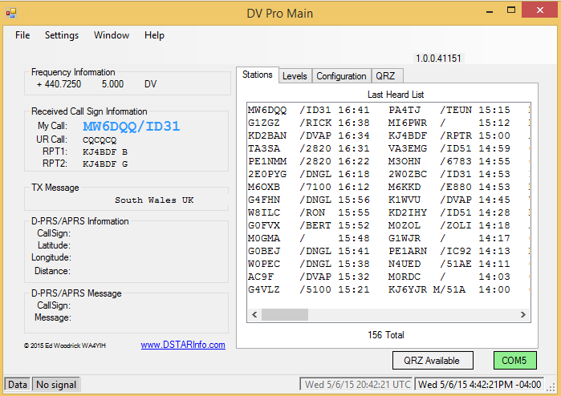
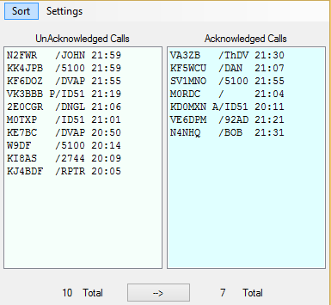
DV Pro Windows

Slide 27
Robin Cutshaw, AA4RC
Dplus, DVDongle, DVAP

Slide 28
Guus van Dooren - PE1PLM
http://www.dvmega.auria.nl/

Slide 29
Fred van Kempen - PA4YBR
https://www.dutch-star.eu/
Notes:
Fred van Kempen PA4YBR

Slide 30

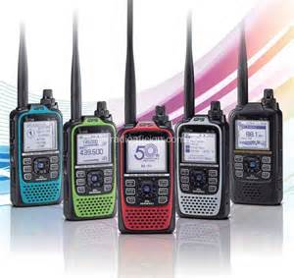
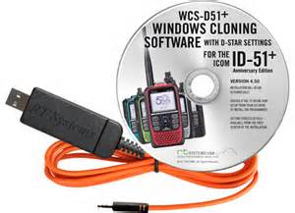
Door Prizes

