Slide 1
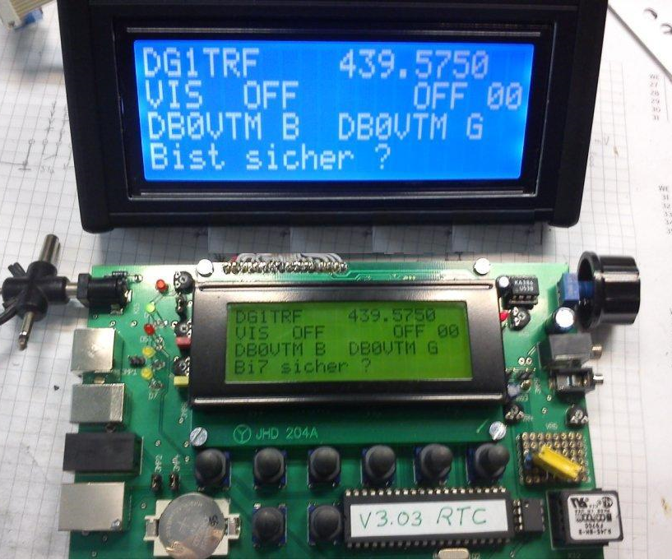
DG1TRF – FA-DV Adapter Kit

Slide 2
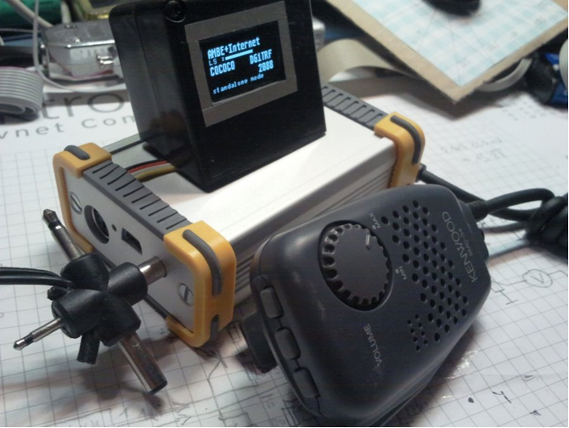
DG1TRF DVRPTR V1

Slide 3
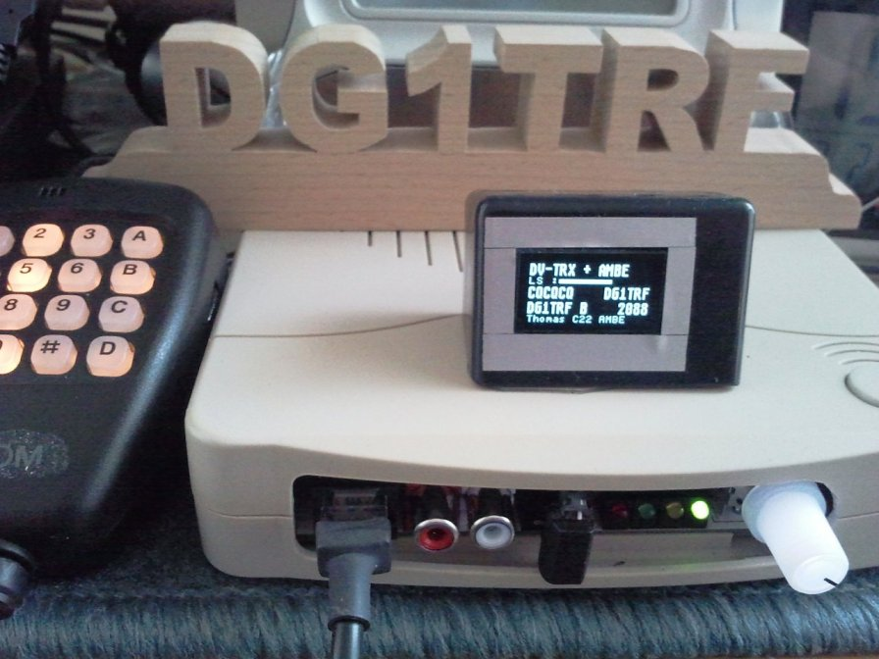
DG1TRF DVRPTR DV2

Slide 4
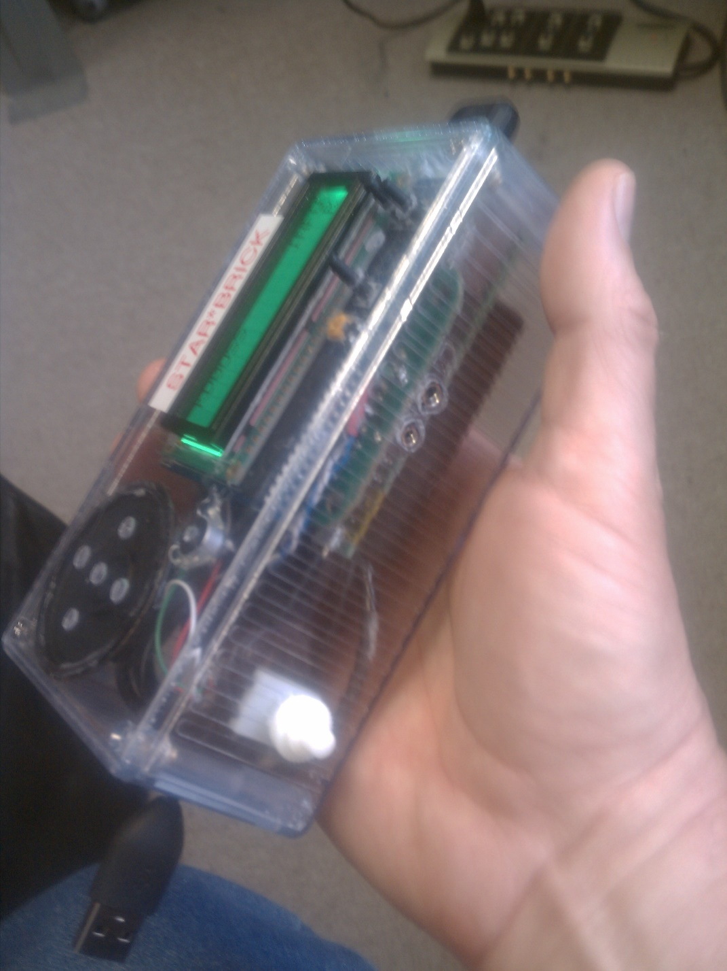
KD0SS – Star*Brick

Slide 5
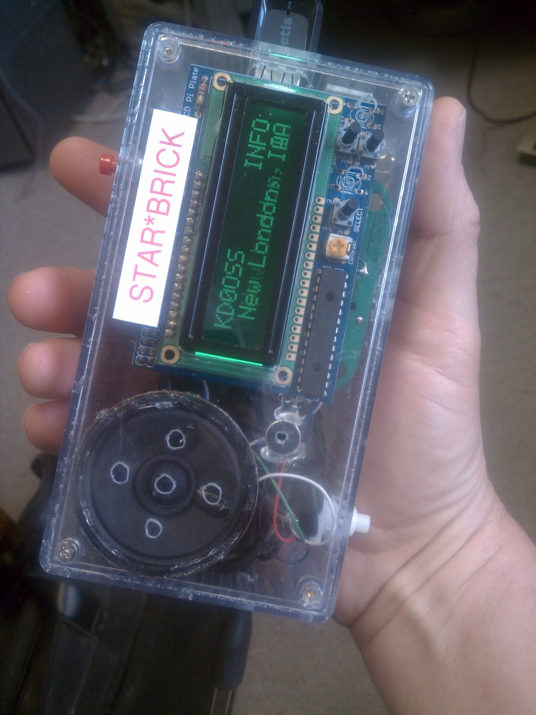
KD0DSS – Star*Brick

Slide 6
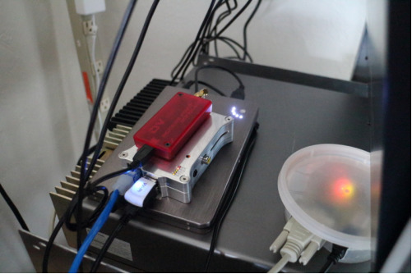
K0RV Repeater

Slide 7
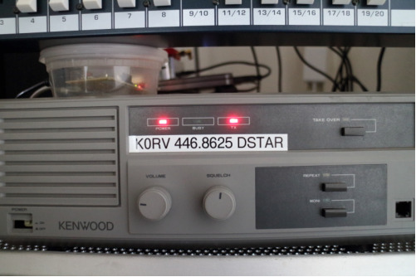
K0RV Repeater

Slide 8
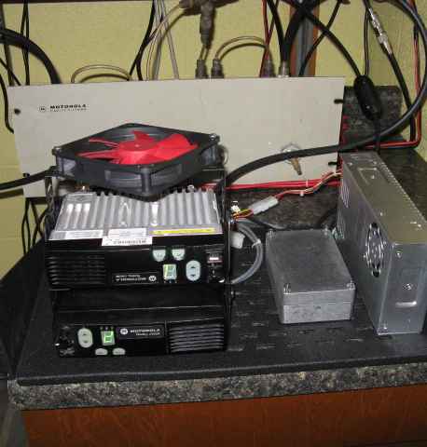
K8RRG Dstar Repeater
2 Motorola CM 200 UHF
1 TX & 1 RX
Moencomm Star*Board in the aluminum box
HP 5710 Thin Client, before BBB and rpi images
g2_ircddb and g2_link by Scott Lawson, KI4LKF with updates from the Ramesh Dhami, VA3UV and the Freestar team.
Simple software solution that uses minimal resources and runs with no interaction
Ability to connect to dxtra, dplus and dcs
www.va3uv.com
www.moencomm.com

Slide 9
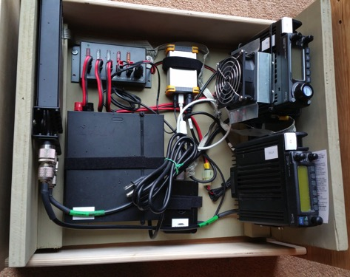
KG7PJV B Homebrew D-STAR Repeater
DVRPTR_v1
GMSK Modem
ICOM IC-208H
Transmitter
RIGrunner
4004 USB
ICOM IC-207
Receiver
UHF 6 Cavity
Duplexer
Raspberry Pi B+
Pidora 2014 OS
ircDDBGateway &
DStarRepeater apps
12V Power Supply

Slide 10
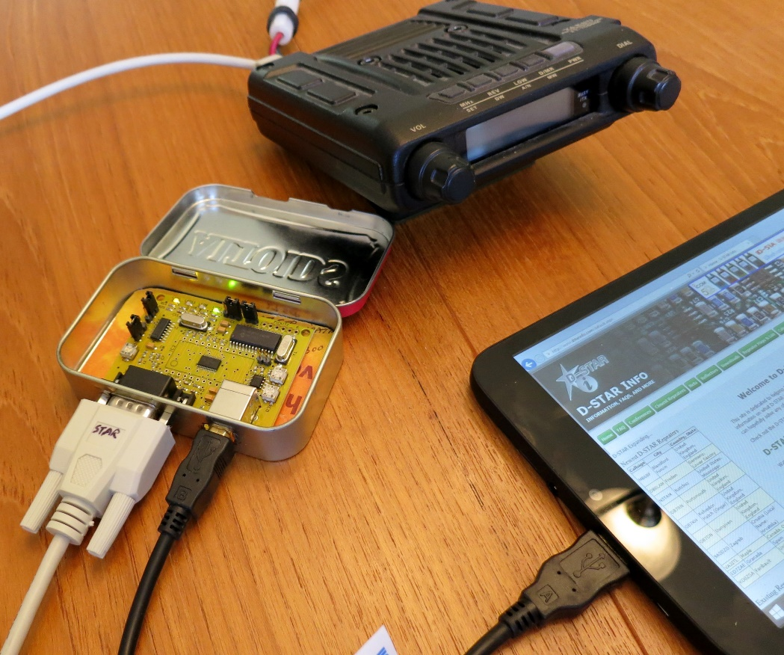
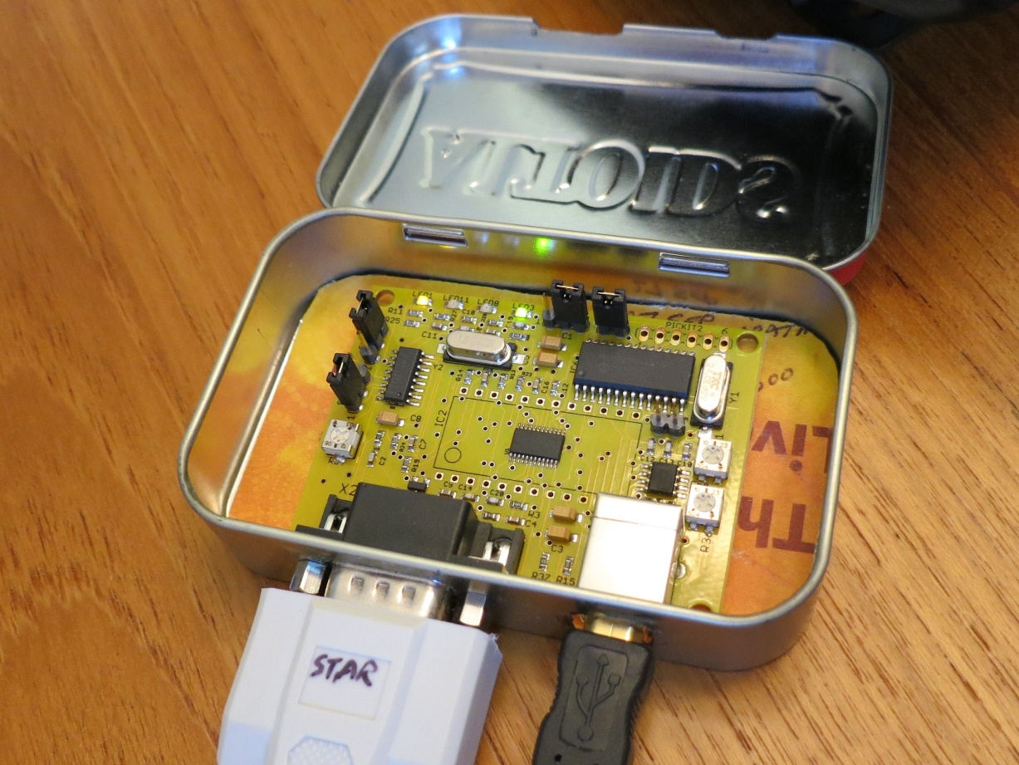
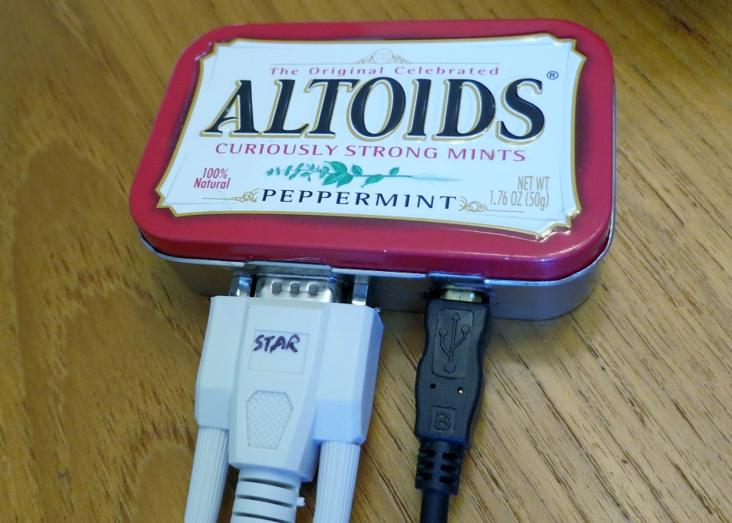
DSTAR 50 WATT VHF HOT SPOT
Moen STAR Board GMSK MODEM
YAESU FT-1500 VHF TRANCEIVER (1990)
ALTOIDS PEPPERMINT TIN CONTAINER
WINBOOK TW800 8.1 SOFTWARE/ACCESS POINT
KQ4KK

Slide 11
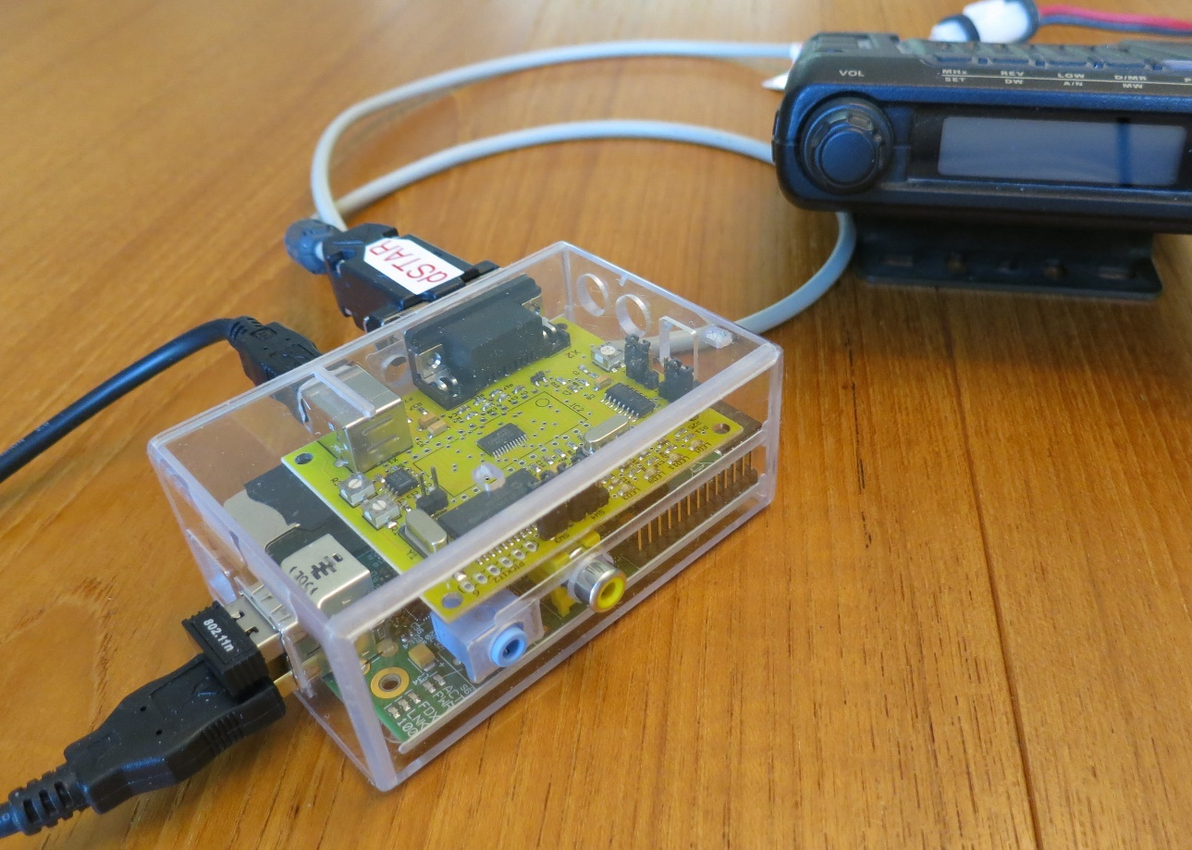
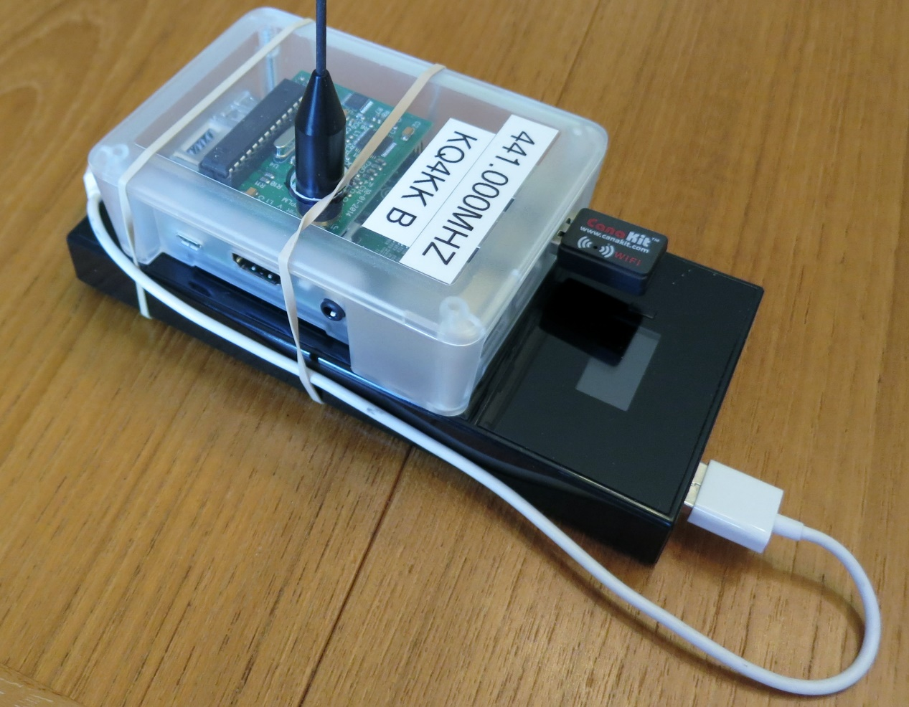
DSTAR 10MW UHF HOT SPOT
DVMEGA 10MW UHF RADIO
RASPBERRY PI SOFTWARE/ACCESS POINT
5VDC LI 15AMP POWER SUPPLY
DSTAR 50 WATT VHF HOT SPOT
Moen STAR Board GMSK MODEM
YAESU FT-1500 VHF TRANCEIVER (1990)
RASPBERRY PI SOFTWARE/ACCESS POINT
KQ4KK

