Slide 1
D-STAR InfoCon 2016 at Dayton Hamvention
Part 1 – D-STAR Basics
John Davis WB4QDX

Slide 2
What is D-STAR?
D-STAR is an open standard for digital voice and data designed specifically for Amateur Radio
One of several digital modes used in Amateur Radio
Developed by Japan Amateur Radio League (JARL)
Uses AMBE vocoder chip from DVSI to convert analog speech to data and vice versa
D-STAR has lead the way encouraging experimentation and open development

Slide 3
Digital Basics
Digital voice does not gradually degrade in quality as signal level decreases

Slide 4
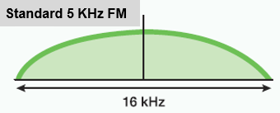
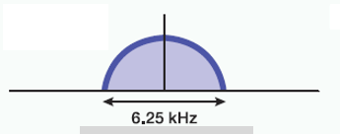
Digital Basics
Voice (analog) is converted to data
Data may be added to voice to produce a single data stream containing voice and data
Radio is modulated as a data carrier
Occupied bandwidth is determined by data bit rate and type of modulation
Generally, digital voice and data occupies less spectrum than analog FM
Narrowband Digital

Slide 5
Digital Mode Comparison
 | D-STAR | DMR/MotoTRBO | System Fusion
Number of users | >46,000 | >30,000 | >1,000
Repeaters | >3,000 | >500 | >1,500 (most operating in mixed or FM modes)
Bandwidth | 6.25 KHz | 7.6 KHz | 7.6-9 KHz
Channel spacing | 10, 12.5 KHz pairs | 12.5 KHz pairs | 20, 25 KHz pairs
Repeater Linking | Open via Internet (DPLUS or ircDDB) | Proprietary (Motorola IPSC), Hytera or special limit3ed reflectors via Internet | Not yet available Wires-X nodes connect to radio
Linking / routing control | Determined by user, sent from radio | Defined by admin, sent from radio | Not yet available for repeater (Repeater firmware upgrade required)
Data | 1200, 3600 bps 128 kbps (1.2 GHz) | SMS only implemented in Amateur Radio version | 4800, 9600 bps
Radio Programming | Front panel, software | Licensed software | Front panel, software
Other user devices | Multiple vendors (Dongle, DVAP, GMSK modems, hotspot adapters) | Multiple radio vendors, multi-mode devices available with limited networking | Not yet

Slide 6
How does D-STAR work?
Voice is converted to digital modulation and transmitted at 4800 bps
    2400 bits for voice
    1200 bits for Forward Error Correction on voice
    1200 bits for data (error correction usually in applications
True narrowband digital signal
  Voice and data occupy one 6.25 KHz signal (versus wider bandwidth for FM voice, P25 and MotoTRBO)
Can operate simplex, repeater or linked to other repeater(s)

Slide 7
What can D-STAR Do?
Transmit or receive voice and 1200 baud data simultaneously on 2m, 440 and 1.2 GHz (no TNC required)
128 Kb data transmission on 1.2 GHz with Internet connectivity (Ethernet bridge to Internet with IP address)
D-PRS (digital APRS) automatic position reporting simultaneous with voice with GPS
Flexible repeater linking with Gateway and Internet connection
Reflectors act as conference bridge for linking multiple repeaters (77 DPLUS Reflectors, >100 DCS and XRF Reflectors now in operation worldwide)
DV Dongle, DV Access Point (DVAP) / Hotspots and DV Node Adapters allow voice and data access to D-STAR via Internet connection (similar to EchoLink)

Slide 8
D-STAR Growth Continues
As of May 1, 2016 – over 3,200 Voice Repeaters, 222 Data Modules and over 47,000 registered users on US Trust Server.
Over 1,100 repeaters in US
Additional ircDDB repeaters and users

Slide 9
D-STAR Equipment
D-STAR radios (mobiles, handhelds, repeaters) commercially produced by ICOM (new major manufacturer announcing soon)
DV Dongle is non-radio device allowing access to repeaters and reflectors via Internet (similar to EchoLink)
DV Access Point (DVAP) creates low power hotspot via Internet
Hotspot boards create low power access point with Raspberry Pi
Node Adapters converts FM transceiver to D-STAR hotspots and repeaters

Slide 10
Icom Radios
Offers line of mobiles, handhelds and repeaters
Most radios are dual band (2m, 70cm)
    ID-31A is 70cm only
    ID-1 is 23cm only, allows high speed data
All radios operate standard FM and D-STAR digital modes
All Icom radios have built-in serial port for data transmission
All offer GPS as built-in, a part of speaker/mic or connection via serial or USB port

Slide 11
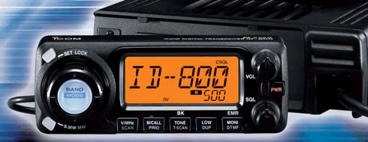
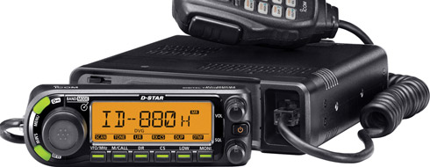
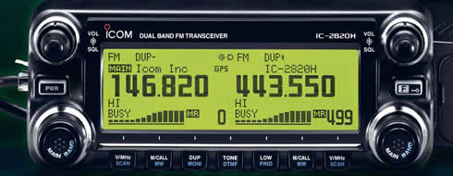
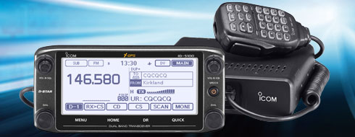
Icom Mobiles
IC-2200 and ID-800 were initial mobiles
    D-STAR board can be added to IC-2200
ID-880 updated ID-800 with improved user functions
    Dual-band, single receive mobile
IC-2820 is full featured mobile
    Dual-band, dual receive
    Built-in GPS with external antenna
New ID-5100 mobile offers new features
    Dual-Band, dual receive
    GPS built into head unit
    Touchscreen display
    Optional Bluetooth interface
    DR Mode with 1200 geocoded memories

Slide 12
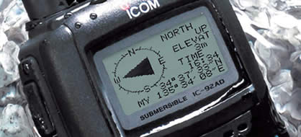
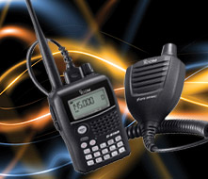
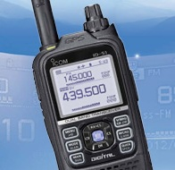
Icom Handhelds
IC-91AD was initial D-STAR handheld
    Dual-band, dual receive
IC-92AD dual-band, dual receive
    Slightly larger frame with more heat sink
    Waterproof
    GPS spkr/mic optional accessory
IC-80 introduced as lower cost handheld
    Dual-band, single receive
    GPS spkr/mic accessory available
ID-31A is 70cm handheld
    Waterproof
    SD card for memory storage, update memory from downloads
    Built-in GPS
    User friendly DR Mode, locate closest repeater
ID-51A is latest dual band handheld
    All features of ID-31A, but dual band, dual receive
    Anniversary Edition/Plus model includes nearest FM repeater location
    3X data rate with other 51A/5100 radios

Slide 13
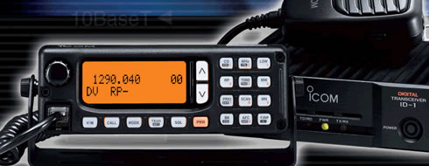
ID-1 for 1.2 GHz Voice and Data
Operates FM, Digital Voice (DV), low speed data and high speed data (DV)
High speed data connection is Ethernet compatible
Acts as Ethernet bridge

Slide 14
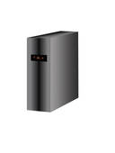
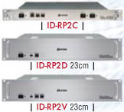
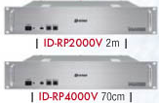
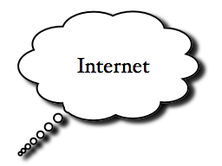
D-STAR Repeater Architecture
Linux Gateway PC
Running G2 Gateway software
Runs third-party apps, Dongle, DVAP

Slide 15
The Registration Process
Why register?
Registering your callsign allows access to more functions on DPLUS repeaters (not required for ircDDB repeaters)
Register on your local or the closest system, if possible
Register on one and only one system (local registration syncs with all systems throughout world)
Registration is a three-step process (all three steps must be completed)

Slide 16
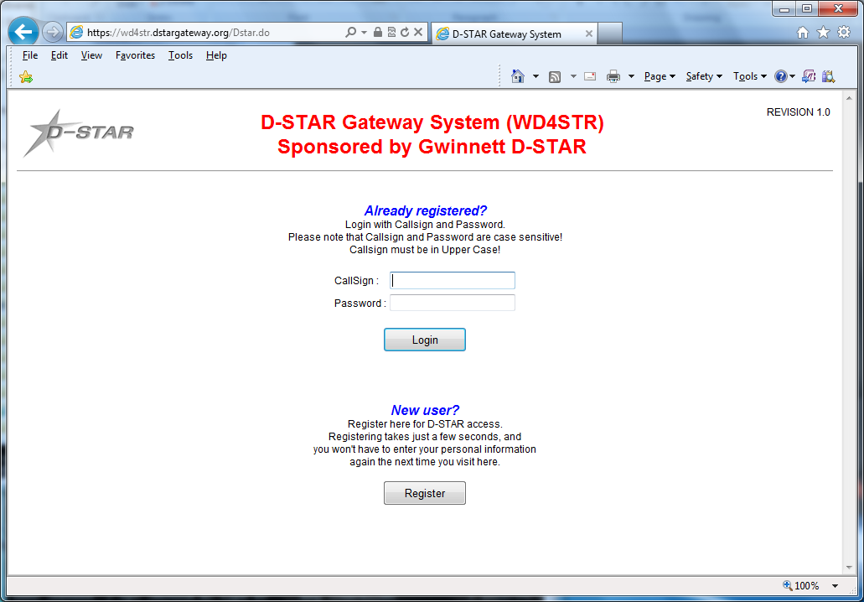
Starting Registration
  Step 1 – Browse to desired system and register as new user (https://callsign.dstargateway.org/Dstar.do)
16

Slide 17
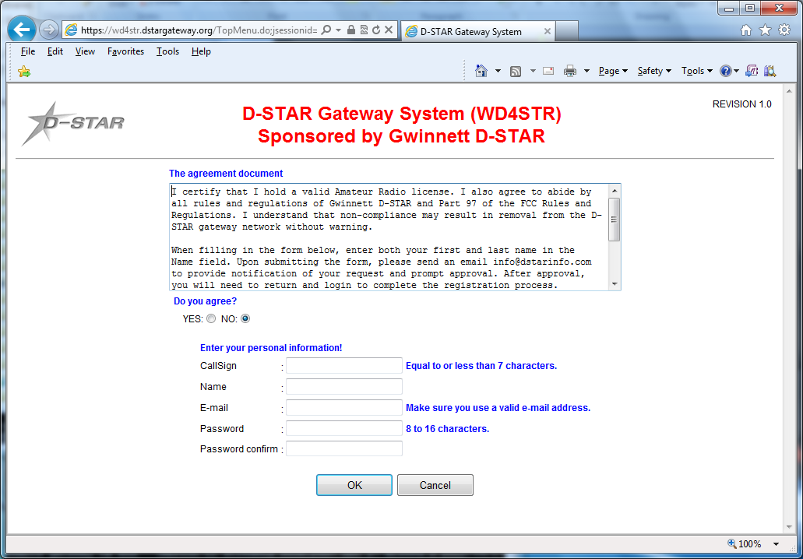
Fill Out Your Info
Fill out the info (callsign, name, email address and desired
password)
  Step 2 – System administrator must approve your initial
  registration. You may need to send email to admin.

Slide 18
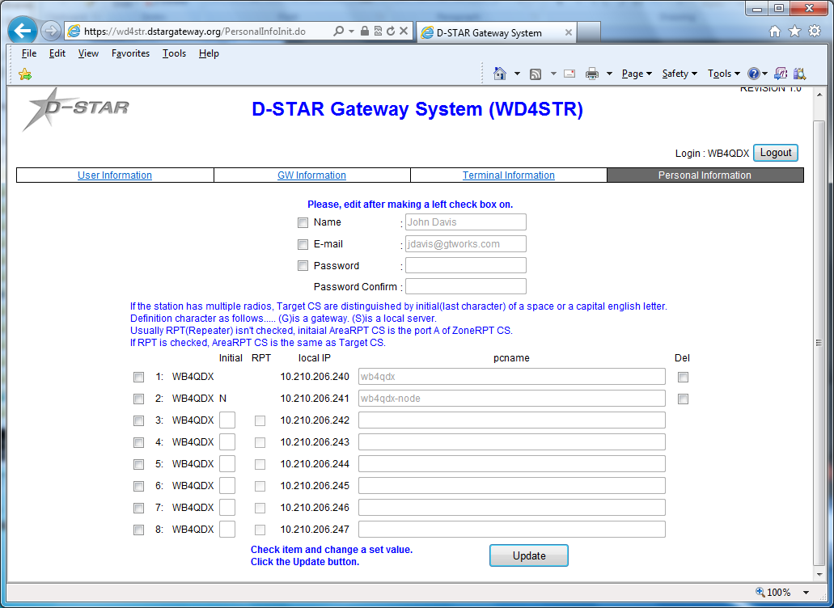
Add a Terminal
  Step 3 – Add at least one terminal with a space in first row
  under Initial, then type a pc-name (lower case,
  e.g. wb4qdx-dstar)
Note: You only need one terminal, a “space” for use. Adding more terminals can add confusion

Slide 19
Add Your Callsign to Radio
For a radio, program your callsign (caps, no spaces) in MYCALL or MY field
  Found in Menu under MY STATION in newer radios
For a DVAP, DV Dongle or Hotspot, program call in callsign field exactly as entered in registration terminal
Get on and talk!

